Slide 1
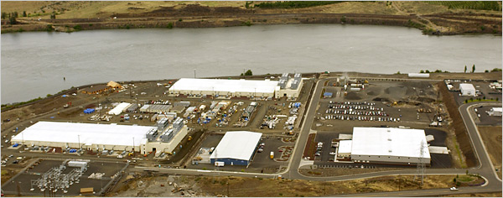
Google Datacenter

Slide 2
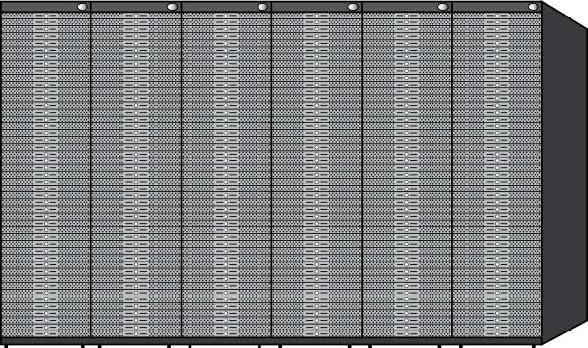
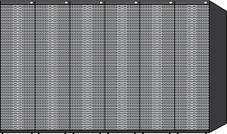
Datacenter Organization
Single server:
4-8 cores
DRAM: 4-16GB @ 100ns
Disk: 2 TB @10ms
Rack:
50 machines
DRAM: 200-800GB @ 300 µs
Disk: 100TB @ 10ms
Row/cluster:
30+ racks
DRAM: 6-24TB @ 500 µs
Disk: 3 PB @ 10ms

Slide 3
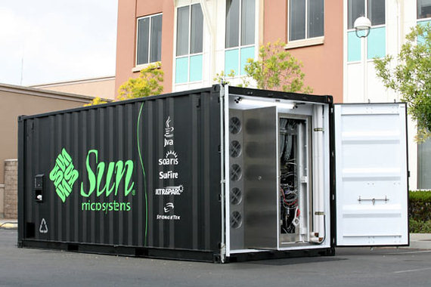
Sun Containers

Slide 4
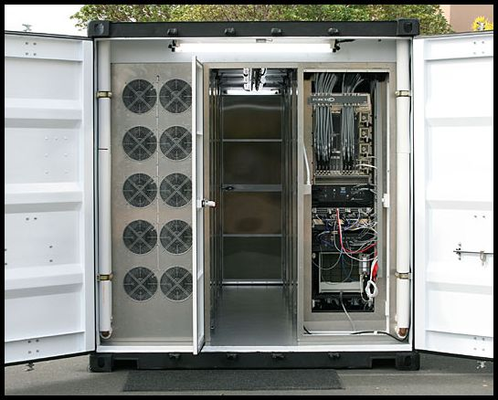
Sun Containers, cont'd

Slide 5
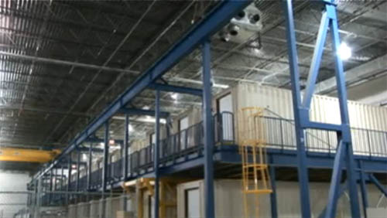
Google Containers

Slide 6
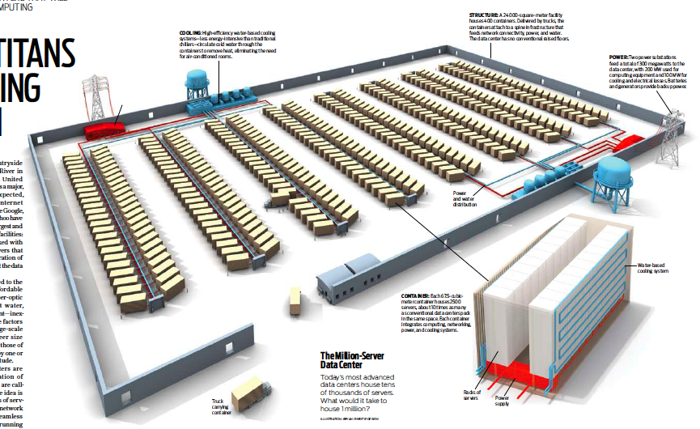
Microsoft Containers

Slide 7
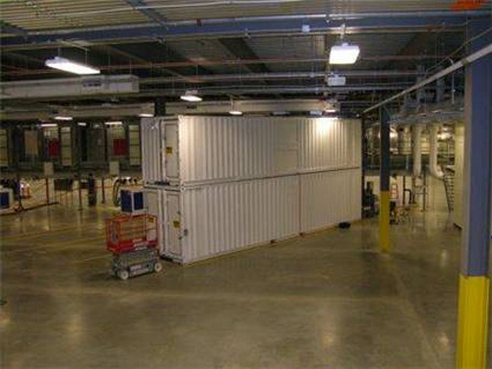
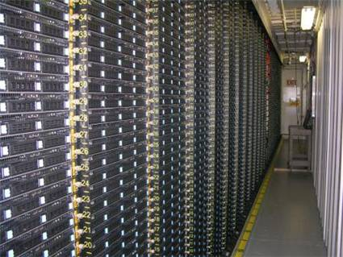
Microsoft Containers, cont'd

Slide 8
Failures are Frequent
Typical first year for a new cluster (Jeff Dean, Google):
  ~0.5 overheating (power down most machines in <5 mins, ~1-2 days to recover)
  ~1 PDU failure (~500-1000 machines suddenly disappear, ~6 hours to come back)
  ~1 rack-move (plenty of warning, ~500-1000 machines powered down, ~6 hours)
  ~1 network rewiring (rolling ~5% of machines down over 2-day span)
  ~20 rack failures (40-80 machines instantly disappear, 1-6 hours to get back)
  ~5 racks go wonky (40-80 machines see 50% packet loss)
  ~8 network maintenances (4 might cause ~30-minute random connectivity losses)
  ~12 router reloads (takes out DNS and external vips for a couple minutes)
  ~3 router failures (have to immediately pull traffic for an hour)
  ~dozens of minor 30-second blips for DNS
  ~1000 individual machine failures
  ~thousands of hard drive failures
  Slow disks, bad memory, misconfigured machines, flaky machines, etc.
  Long distance links: wild dogs, sharks, dead horses, drunken hunters, etc.

Slide 9
How Many Datacenters?
1-10 datacenter servers/human?
100,000 servers/datacenter
80-90% of general-purpose computing in datacenters?
 | U.S. | World
Servers | 0.3-3B | 7-70B
Datacenters | 3000-30,000 | 70,000-700,000

