Slide 1
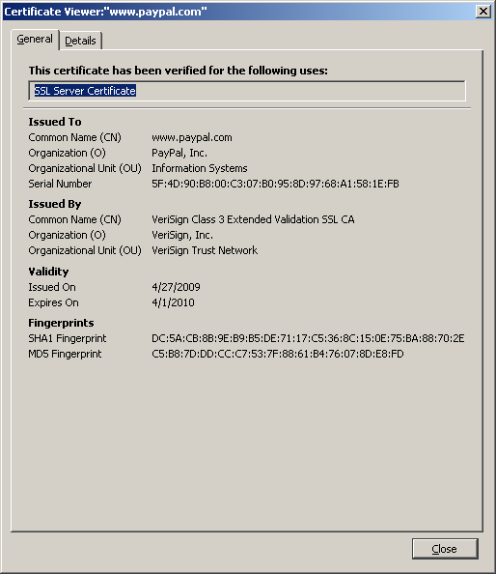
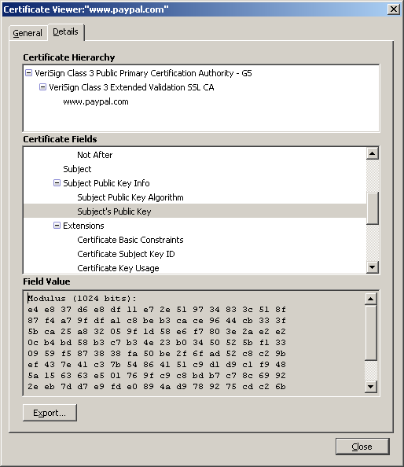
Certificates

Slide 2
SSL/TLS Overview
Browser
client-hello
Server
server-hello + {server-cert}SK_{CA}
Key exchange (several options)
Random
key K
client-key-exchange: {K}PK_{server}
K
{HTTP data}K
Most common: only the server is authenticated

Slide 3


SSL Stripping
Replace https:// with http://
Active
Attacker
HTTP request
HTTP request
Modified response
HTTP response
HTTP request
HTTPS request
Browser
HTTP response
HTTPS response
Server
Attacker opens HTTPS session, forwards requests and responses
Attacker observes
private info

Slide 4






HTTPS Indicators
HTTP
HTTPS
Firefox 10
IE 8
Chrome 17
Notes:
Click on fav icon gives pop-up on bottom.
4

Slide 5
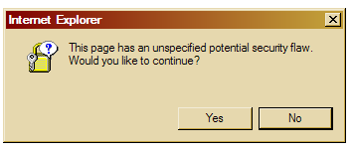



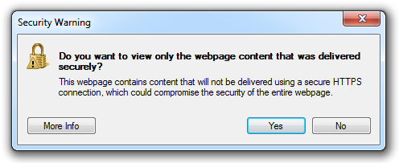
Mixed Content Indicators
Silly dialogs
Firefox 10: no SSL indicator
Chrome 17: caution sign
IE 8: warning dialog, no SSL lock

