Slide 1
Understanding the Universe
Roger Blandford
KIPAC
Stanford

Slide 2
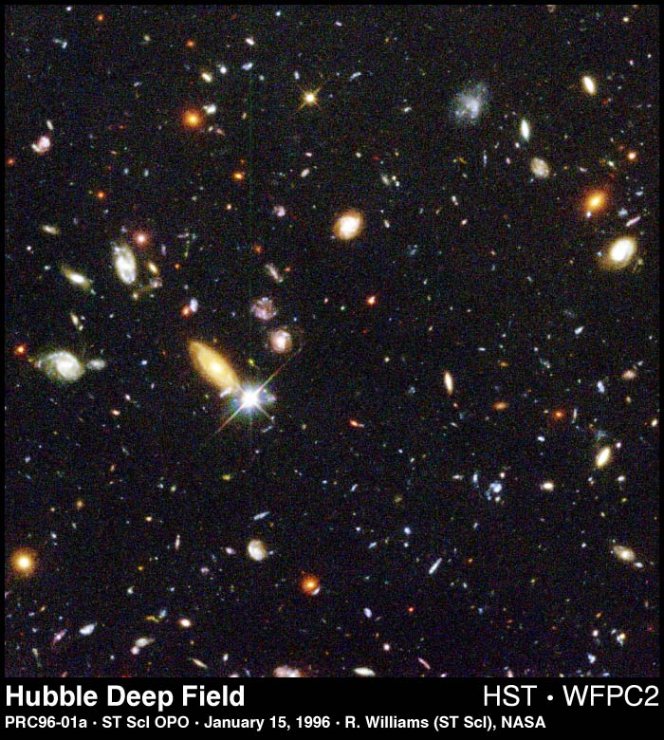
Notes:
The Universe is a very big place. It is getting bigger. This remarkable fact discovered almost a century ago by Vesto Slipher and codified by Edwin Hubble, memorialized in this famous image, tells us that the universe that we can see about us today was once very small and had a beginning – the “Big Bang”

Slide 3
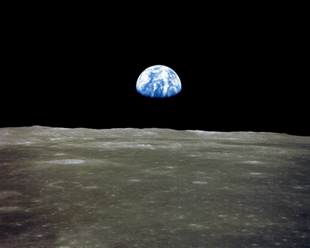
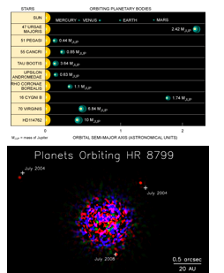
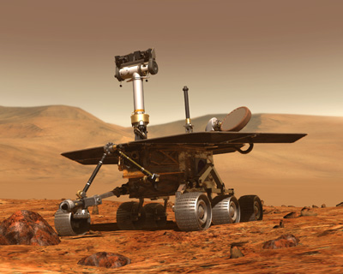
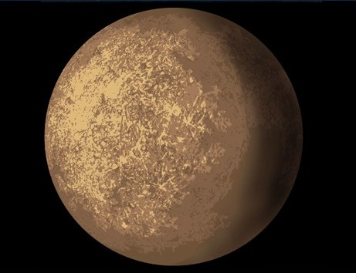
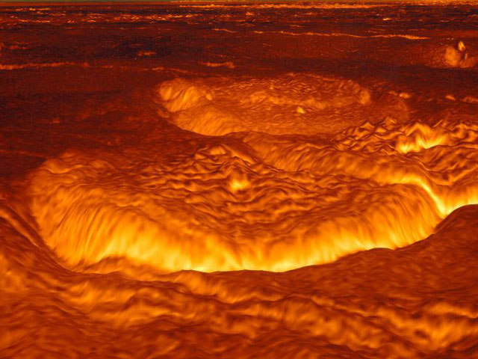
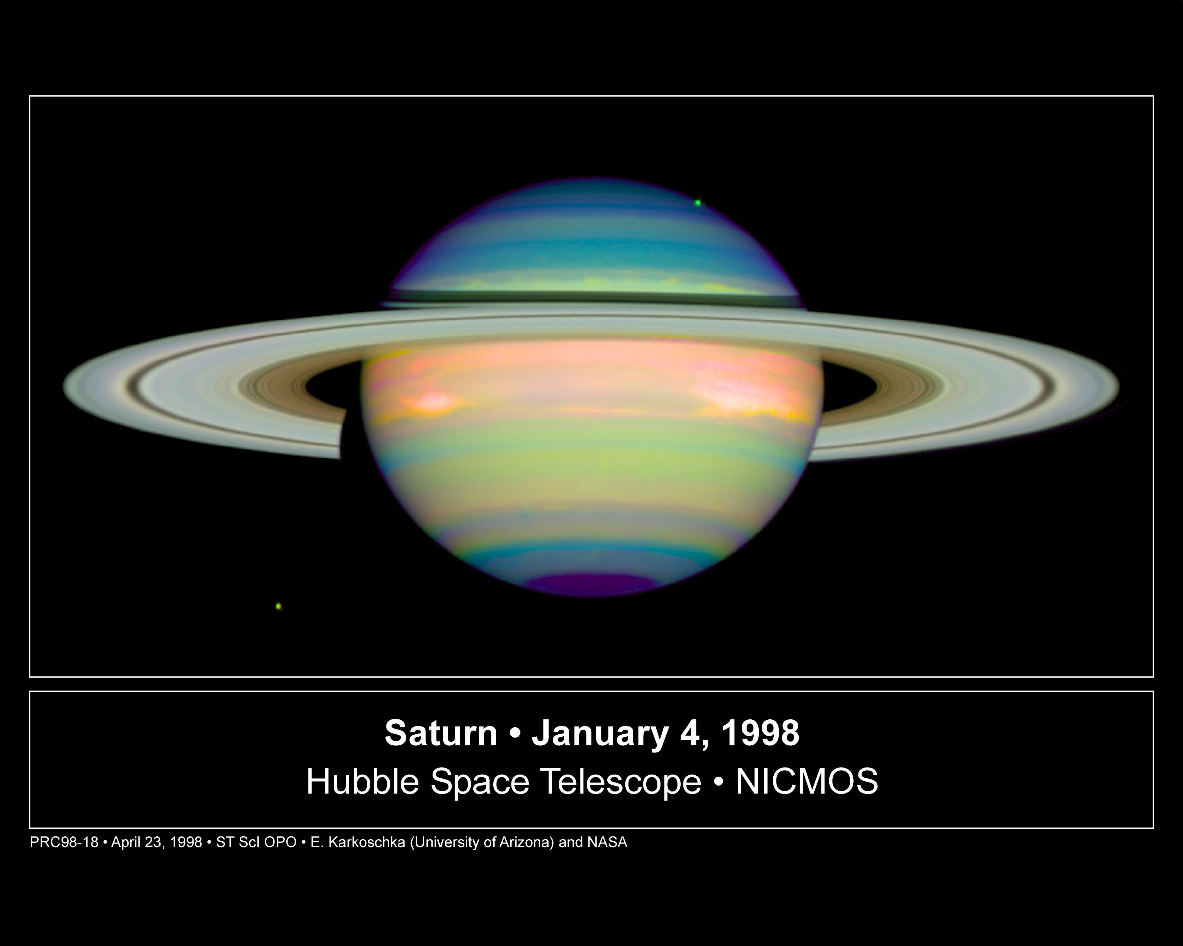
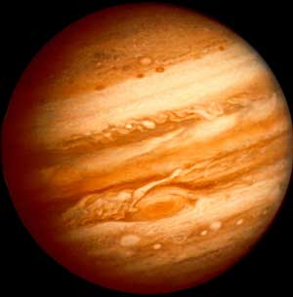
Notes:
The Universe is an egalitarian place. Our ancient disdain for five planets wandering the sky has been displaced by the realization that Earth is just one of the larger pieces of debris orbiting a rather modest star – one in a few hundred billion such stars in the inner suburbs of an unpretentious spiral galaxy – again, one in a few hundred billion galaxies in the observable universe - the junior partner in a small and unremarkable group of galaxies. And, it is now clear, most of these stars in most of these galaxies have their own planetary families, each unhappy in its own way. So much for terrestrial exceptionalism.

Slide 4
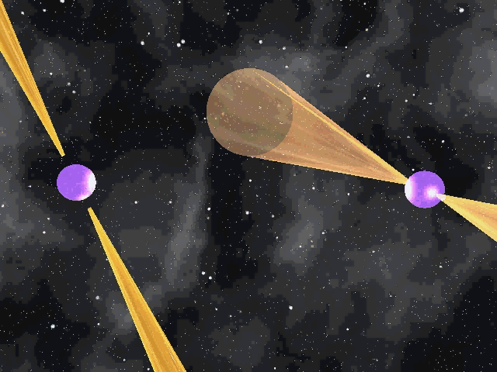
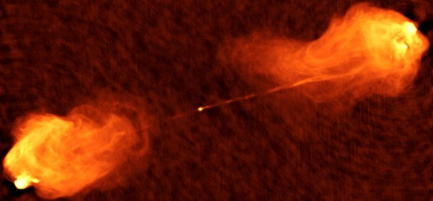
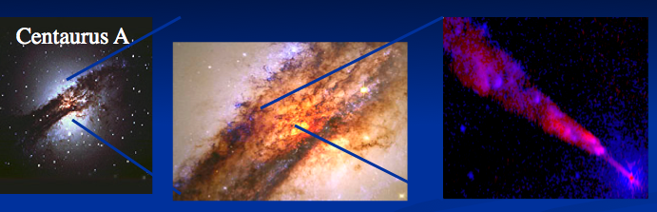
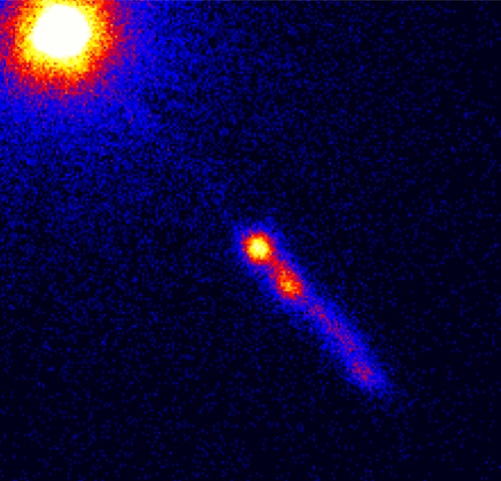
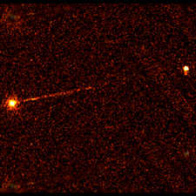
Pulsars
Cygnus A
3C 273
First quasar
Pictor A
Notes:
The Universe is a strange place. We have become acquainted with some of its remarkable denizens, white dwarfs and neutron stars; black holes big and small; pulsars that spin on their axes 700 times a second, quasars no larger than our solar system that are thousands of times more luminous than all the stars in their host galaxies, radio sources that squirt jets of plasma at speeds close to that of light to escape the gravitational clutches of their galaxies and so on

Slide 5
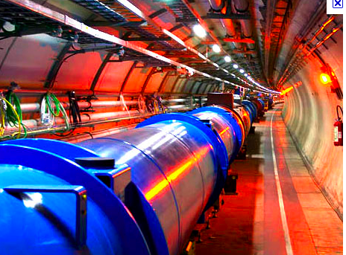
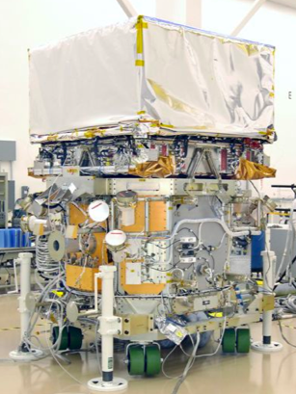
Fermi Gamma-ray
Space Telescope
Large Hadron Collider
Notes:
Most remarkably the atoms and molecules which comprise you and me are minor constituents of the universe. Instead, just over a fifth of the mass energy in the universe is in a mysterious “dark” form that we strongly suspect is a new type of elementary particle that may be created at the Large Hadron Collider or seen indirectly by Fermi Gamma Ray Space Telescope. Identifying the nature of this “dark matter” is one of the major challenges to observational astronomy and fundamental physics.

Slide 6
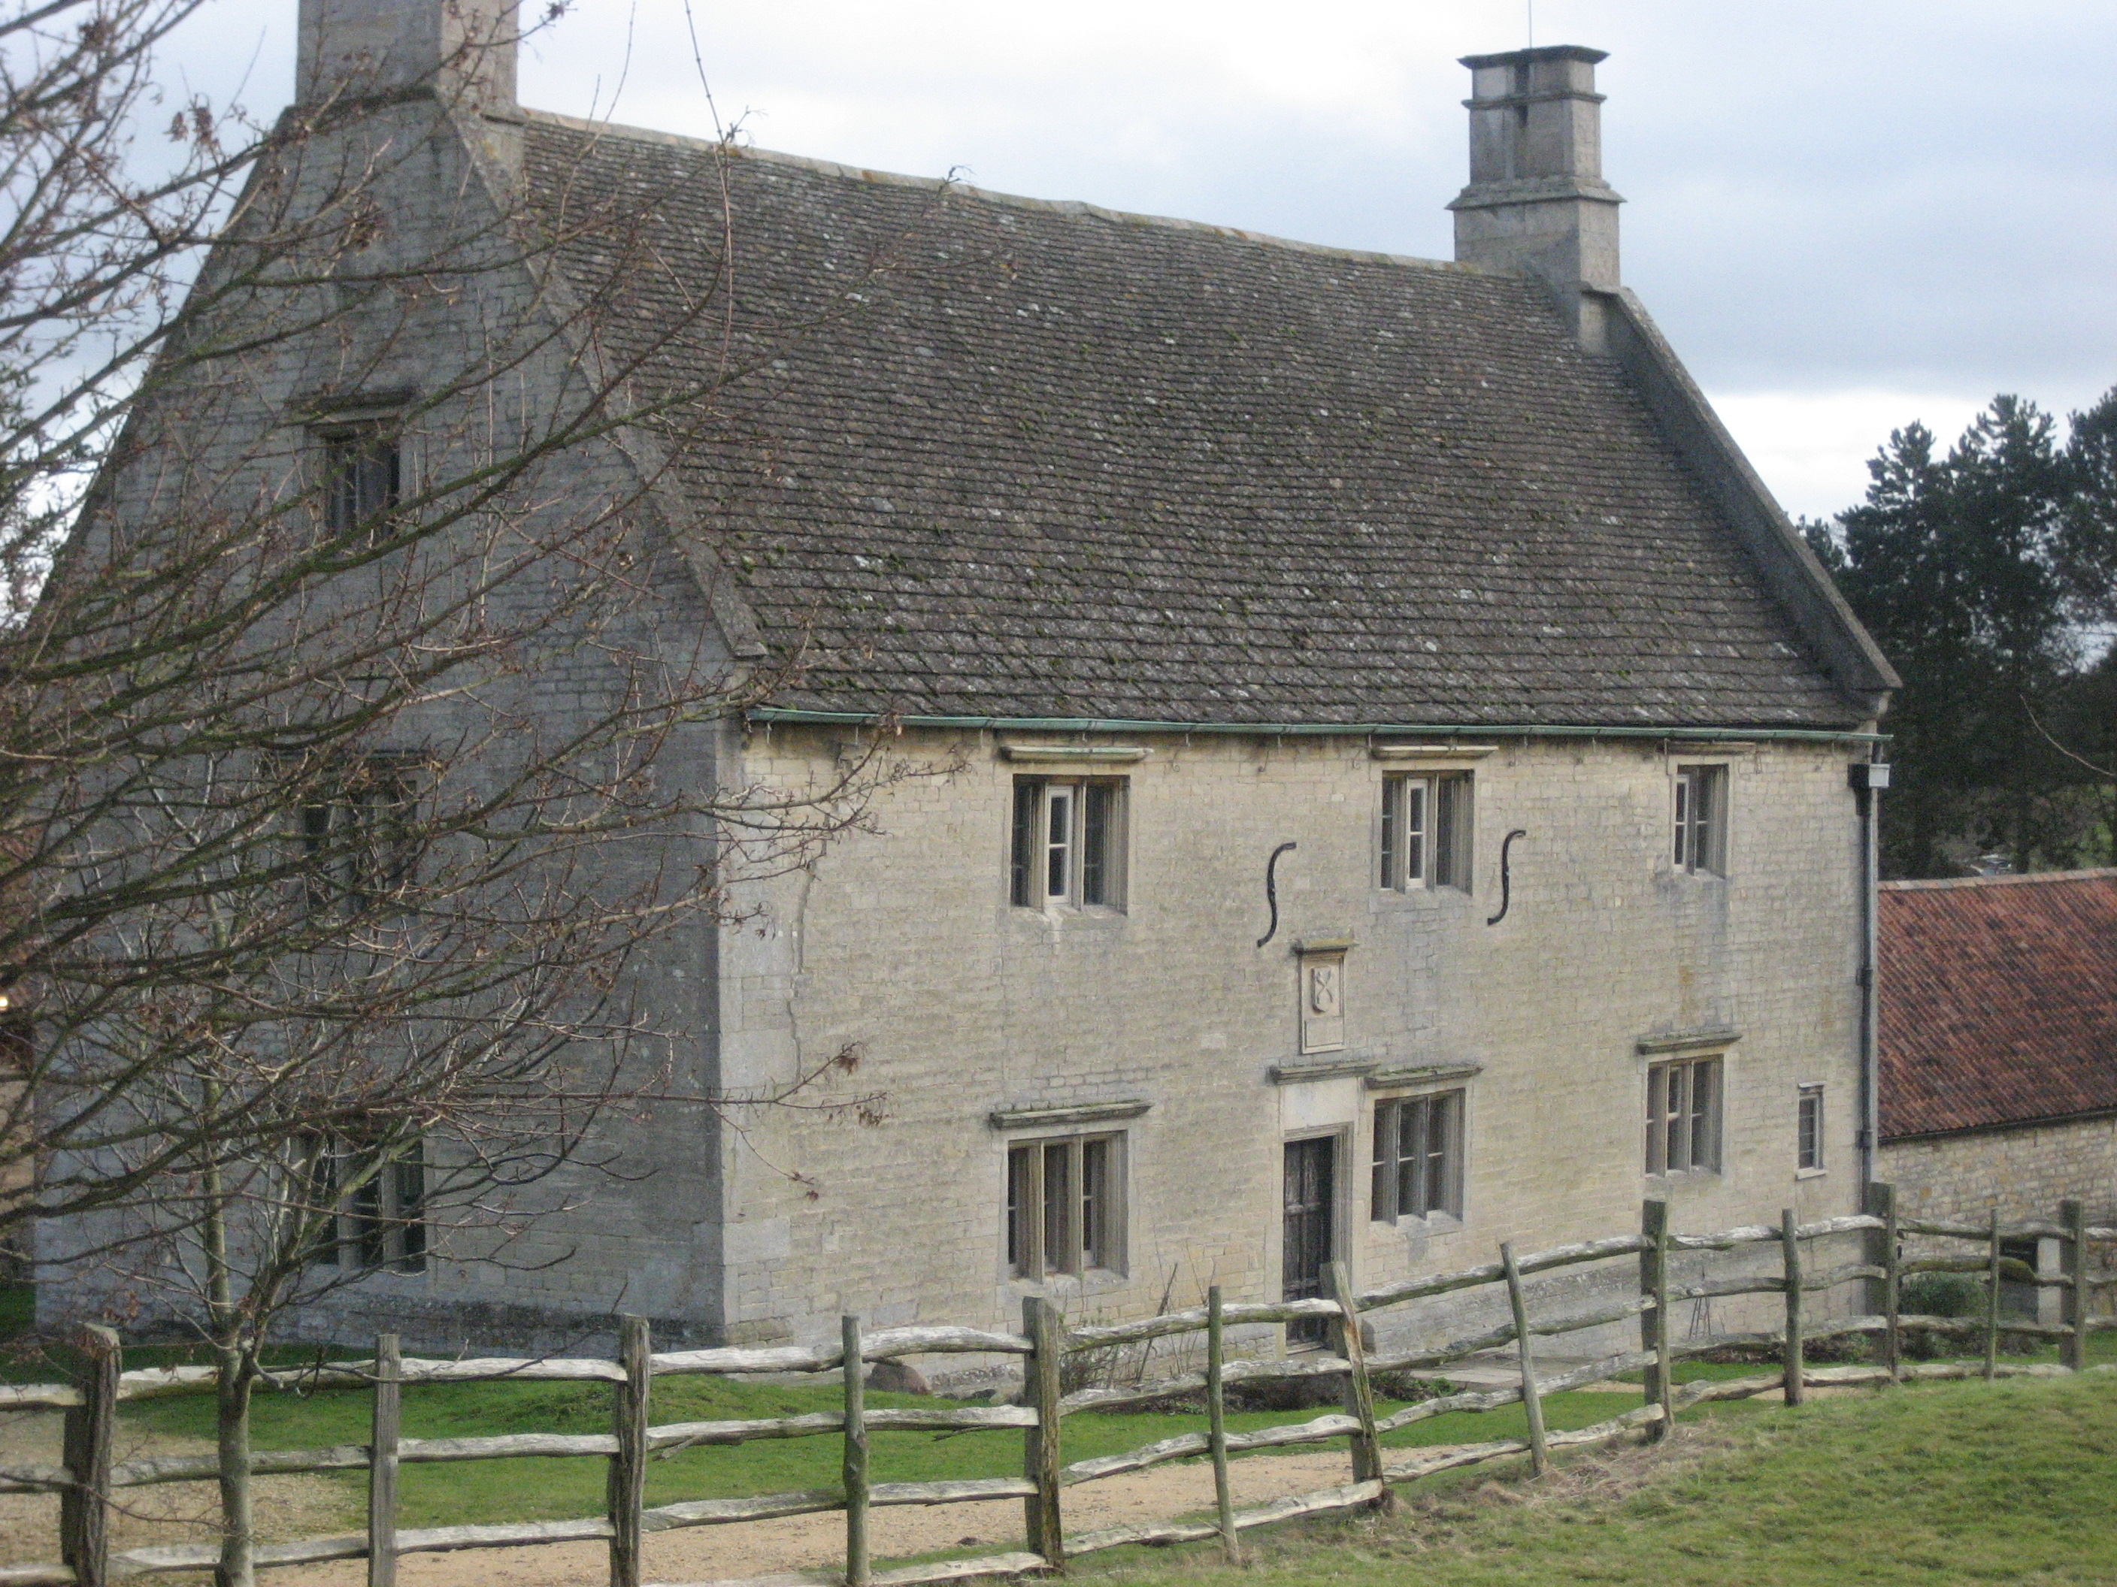

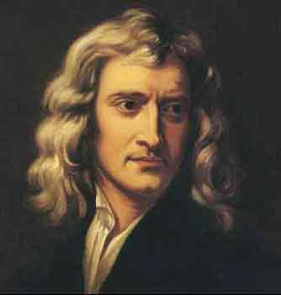
Breaking the Law of Gravity
6
Notes:
Even more remarkable is the discovery, made just 12 years ago, that the Universe is accelerating. It is as if the apple, instead of falling from the tree at Newton’s home flew upwards, like a hot air balloon, moving faster and faster. You can tell the Newton lived here because of the integral signs carved into the wall.

Slide 7
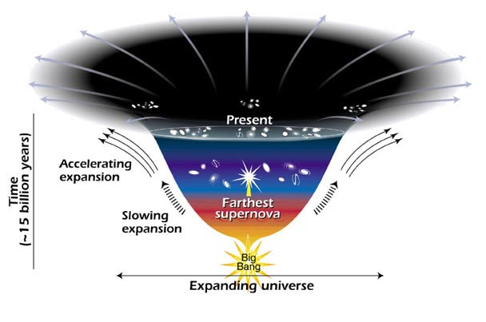
Notes:
. We account for this behavior by invoking a third and major constituent of the contemporary universe which we now call “dark energy”. Dark energy is amazing stuff. Internally it is pulling itself together. However, we believe that energy cannot be created and destroyed and this means that a sufficiently strong mechanical pull leads to a gravitational push. On the large scale the effect here is a strong cosmic repulsion and the galaxies separate at greater and greater speeds. Dark energy appears to be universal and eternal. If so, the cosmos will expand, ever accelerating – condemning us to a gloomy future of dilution and decay, an agoraphobic’s worst nightmare.

Slide 8
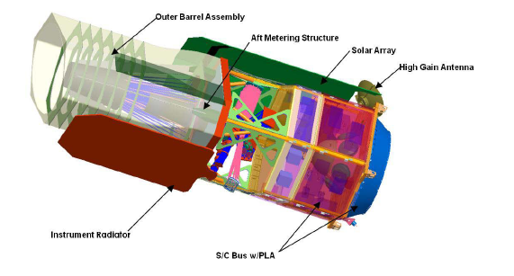
Proposed Wide Field Infrared Survey Telescope
Notes:
Dark energy is not a new idea. It was invoked by Einstein in 1917 and has been entertained as a possibility ever since. However, the realization that it now rules our roost is a stunning discovery and, arguably, an even greater challenge to physics than dark matter. Naming it is so, so much easier than explaining it. We are planning a mission called WFIRST to measure the properties of dark energy and see if, once again, “Einstein was right”.

Slide 9
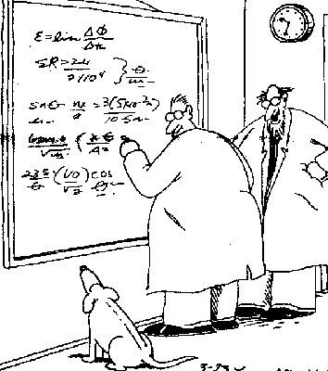
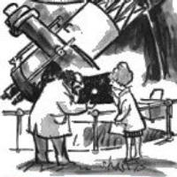
Notes:
What I have sketched is a description of the universe. That it is a cosmic zoo full of strange beasts and that we do not appear to be that special; that it is expanding faster and faster and that most of its contents comprise entities that have not yet been seen in terrestrial laboratories. In fact the universe is performing observing experiments for us in its laboratory and we are eagerly employed watching and learning.

Slide 10
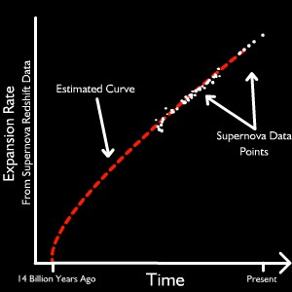
13.7 Billion years
Notes:
However, science is not just about describing; it is also about measurement and if anything characterizes the extraordinary progress of the past half century and, especially, the past decade, it is the advent of precision cosmology. In the past, the age of the universe could as plausibly be claimed to be seven as fifteen billion years old. We now know that its age is 13.7 billion years.

Slide 11
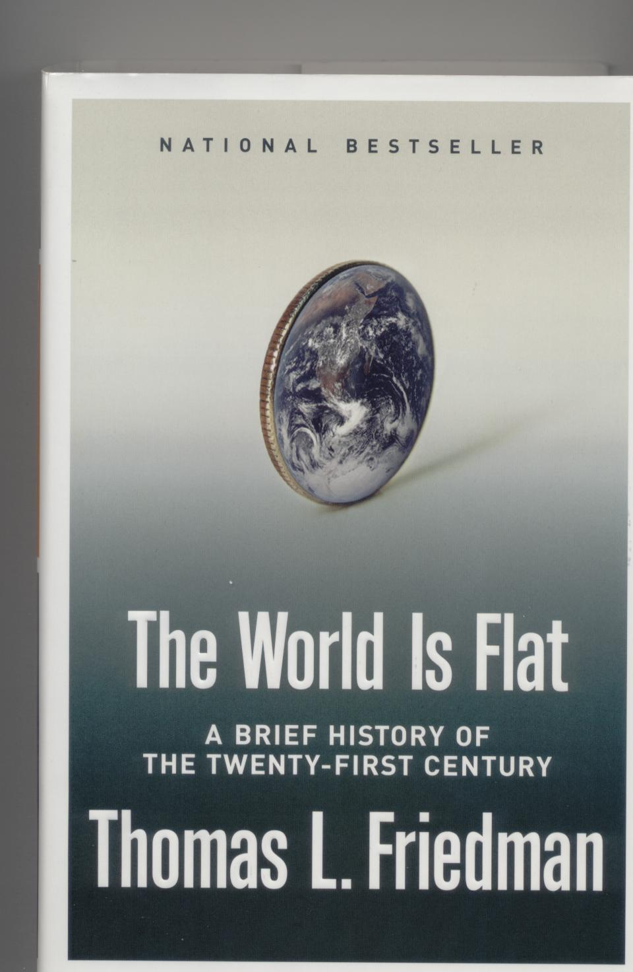
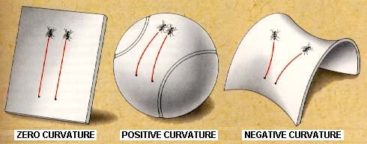


Normal Matter
Dark
Matter
Dark
Energy
Other discretionary
Defense
Mandatory
plus interest
Notes:
We also know that the geometry of the universe is flat – like this screen and unlike the surface of a sphere or saddle – to better than two per cent. We know the proportions of ordinary matter, dark matter and dark energy to perhaps a percent. This reminds me of of something which we are all going to see much of in the coming years is the partition of the federal budget. In short, we have a good, quantitative description of the universe – the standard model of cosmology.

Slide 12
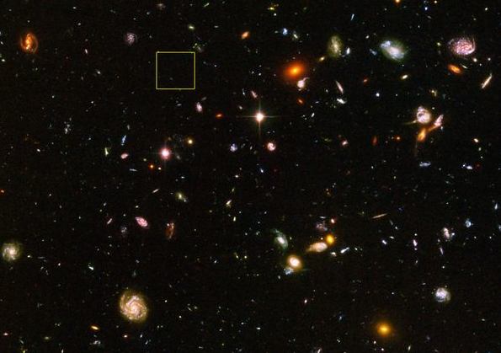
Notes:
As we use telescopes to look out in space, we look back in time. Here is an image of Ultra Deep Field taken by Hubble Space Telescope. It is the deepest exposure ever taken and shows what the dark sky actually looks like. It is teeming with galactic life – like the first time you see a drop of pond water under the microscope. Many of the galaxies that you see here, classified as spirals, ellipticals and irregulars, are close by – our nearest neighbors. Others are distant and seen when the universe was younger because even light takes a while to reach us. A month ago, it was announced that this image contains the most distant galaxy we have ever seen. Spectroscopic work at the European Observatory in Chile has demonstrated that this faint speck of light comes from a galaxy at a time when the universe was only 600 milliion years old, less than five percent of its present age.

Slide 13
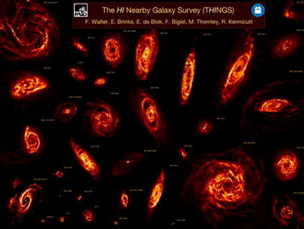
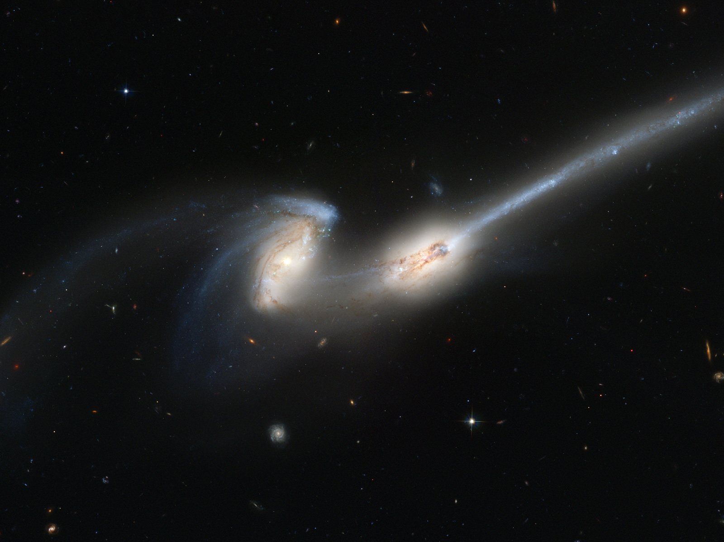
Notes:
Using observations like this we are rapidly assembling and interpreting the fossil record of galaxies. Cosmopaleontology is every bit as fascinating as its geological counterpart. Furthermore the rate at which the galaxies were born, married (through mergers) and, in a sense, died as ellipticals is reconciled with the physics of gravity, atoms, nuclei and radiation, supplemented by some plausible story-telling about the complicated “astrometeorology” that it is hard to forecast from first principles.

Slide 14
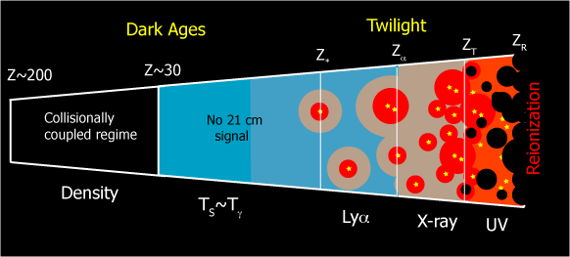
Epoch of Reionization
Notes:
So, when did the first stars, galaxies and black holes form? When was our cosmic dawn? When did the “dark ages”. This turns out to be one of the most pressing questions in modern astronomy. It is one that will be answered by piecing together observations from a suite of telescopes.

Slide 15
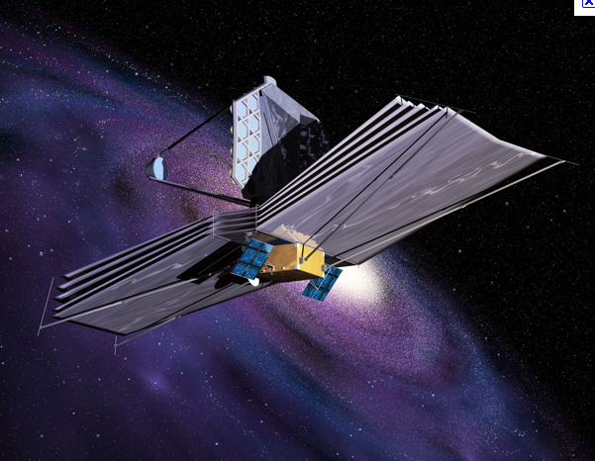
Notes:
Hubble has told us a lot but the mantle will pass some time this decade to James Webb Space Telescope which is larger and observes in the infrared where starlight from these rapidly receding galaxies is received. We will also study them with X-ray telescopes and giant optical telescopes on the ground. Radio telescopes will play a large role as the first stars should “re-ionize” the hydrogen gas in the universe, separate the electrons from the protons and this can be followed by ultra-sensitive observations using a special radio spectral line.

Slide 16
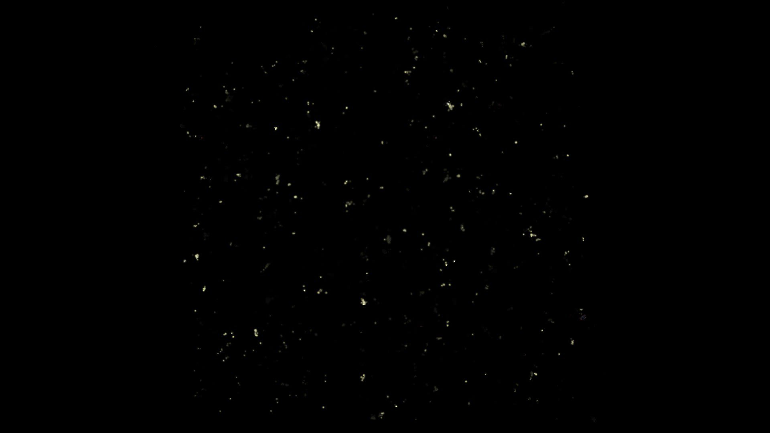
Notes:
We expect that this happened roughly when the universe was five hundred million years and so Hubble may be nearly there. While we are waiting, though, we can get ready by making careful simulations, based upon the known laws of physics that predict what to expect as best as we can. Here are two short clips now shown in science museums made by my colleagues Tom Abel, Marco Alvarez, Ralf Kaehler, Ji-hoon Kim and John Wise.

Slide 17

Notes:
The narrations are by Whoopi Goldberg and Liam Neeson. I believe the next one will feature Jodie Foster. I might remark that, as with animations, this is a good way to fill seats in planetaria.

Slide 18
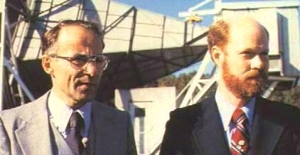
Penzias and Wilson
Discoverers of the Microwave Background
Notes:
We can peer back even further. An accidental discovery from 1965 made to Penzias and Wilson working at Bell Labs was of the cosmic microwave background radiation. We see this from the so-called epoch of recombination when the universe was about half the temperature of the sun – 3000 degrees – and the universe was 400 thousand years old. The wavelength of the radiation when emitted was around a micron in the infrared. The wavelength expanded a thousandfold with the universe and is now about a millimeter.

Slide 19
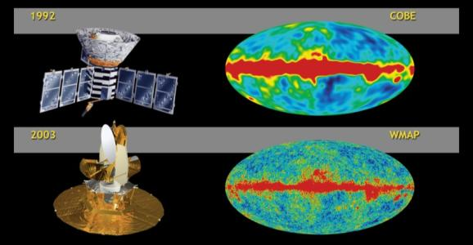
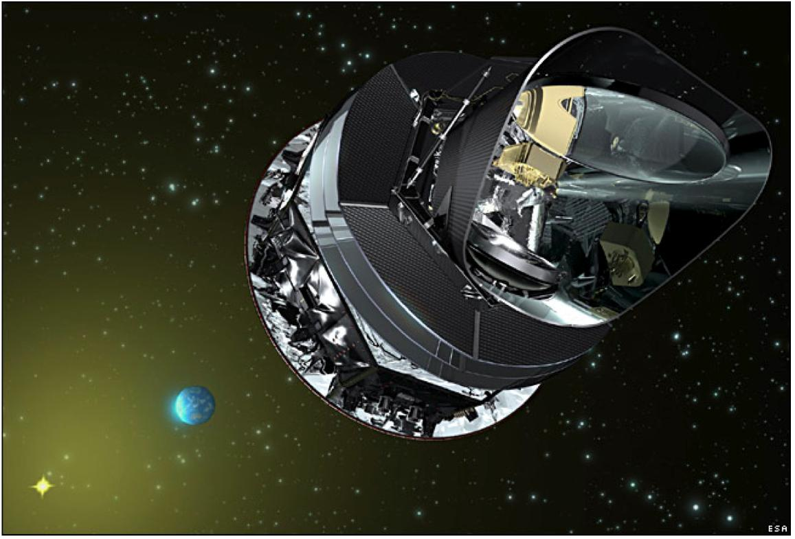
Planck
Notes:
It has been studied intensively on the ground and especially with two space radio telescopes, COBE and WMAP and a third telescope, Planck is taking data as I speak. About half of the measurements that define the standard model of cosmology derive from the microwave background. When first observed, the microwave background appeared featureless and the same in all directions. However using sensitive observations, we can see that there are a few parts per million fluctuations and it is by studying the size, spectrum and polarization of these fluctuations that we learn so much.

Slide 20
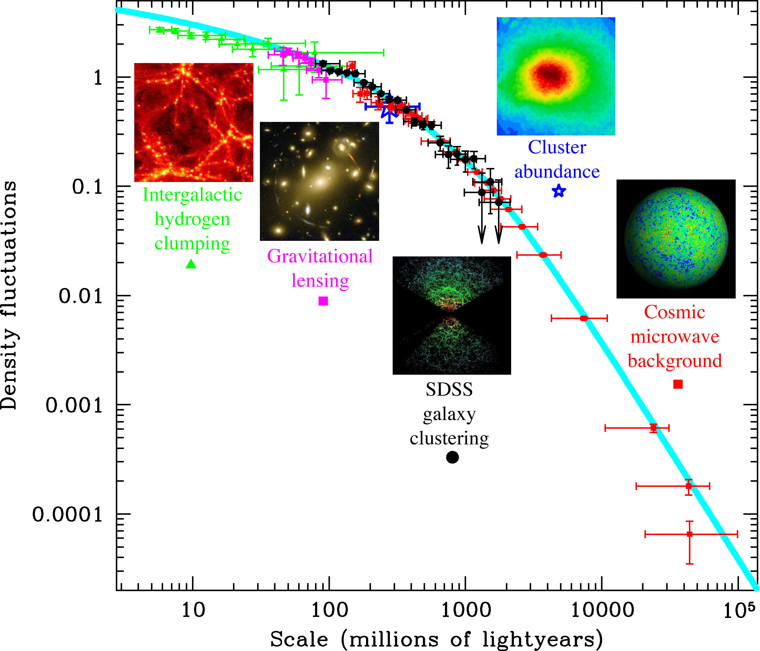
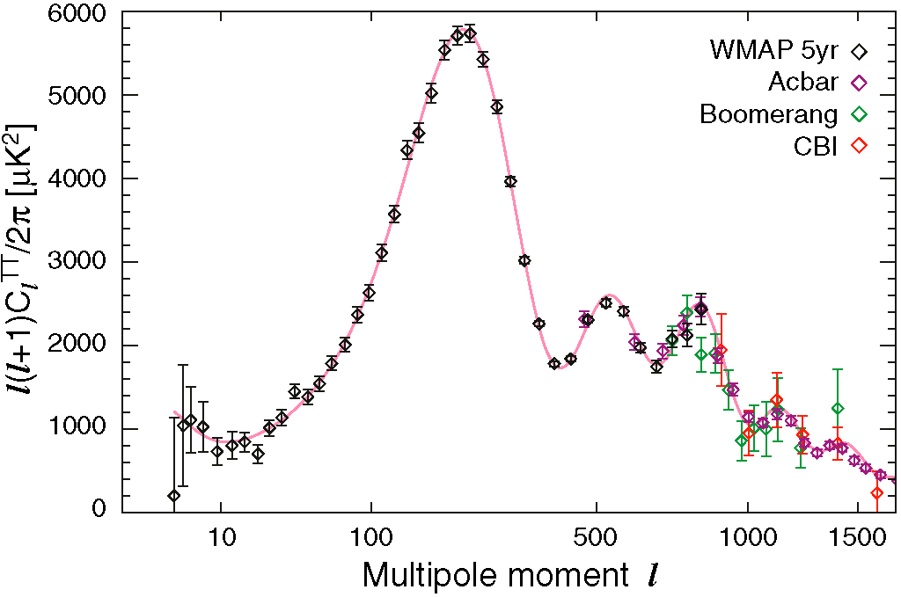
Notes:
Using these very challenging measurements we have been able to reconcile the structure that we see in images like the Ultra Deep Field with the state of the universe when it was less than half a million years old. It all makes sense! This is remarkable scientific progress.

Slide 21
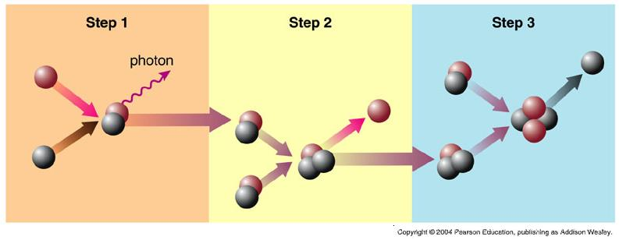
Making Helium in the Big Bang
Notes:
At even earlier times the universe was pretty much opaque as we go backwards in time towards the big bang, the universe was inferred to get hotter and hotter. We enter the realm of nuclear physics when the age was a few minutes and the light elements were synthesized. Again using normal physics, this all makes sense.

Slide 22
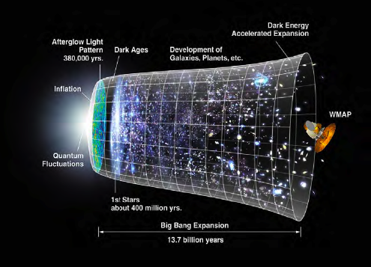
Notes:
Earlier and hotter than this we enter the realm of particle physics and eventually, our understanding eventually comes to an end. Questions abound. Why was the universe left with a tiny excess of matter over antimatter? We would not be having this symposium if it were not so. We have many theories and perhaps one day a means to use observations to choose between them.

Slide 23
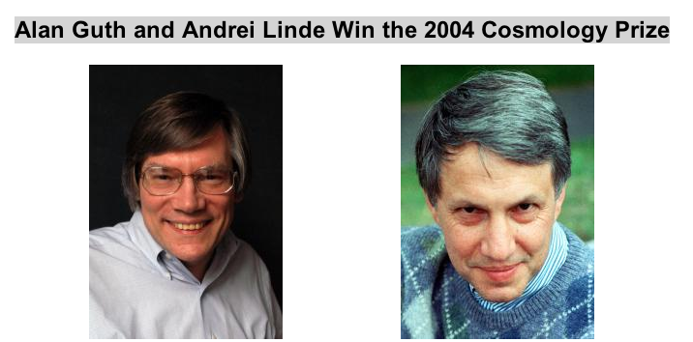
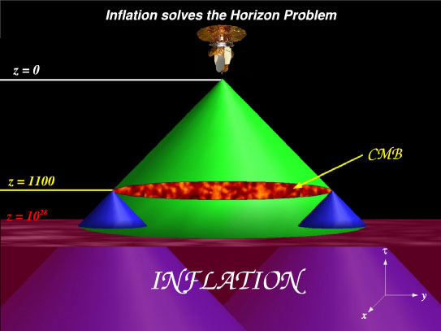
Notes:
Perhaps deepest of all is the question “Why is such a big universe so uniform?” This is a longstanding puzzle and in 1982, it received an imaginative solution from theoretical physicists, Alan Guth, Andrei Linde and others. They suggested that when the universe was a tiny tiny fraction of a second old, it underwent a period of rapid expansion – called inflation – rather like the dark energy fueled acceleration that we are embarking on today. For those of you who were depressed by the prospect of a universe with an unstoppable future of dilution and decay, fer not. We got out of this mess once in the past and if we all try hard, we can do it again!

Slide 24
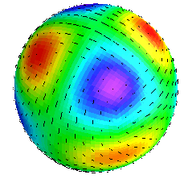
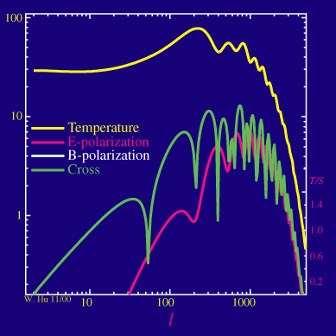
Notes:
Amazingly, the third time I have used this word, the details of the standard model are also consistent with this theory in its simplest form. Even more astonishing is the prospect of actually “seeing” the epoch of inflation using the one signal that can get to us – a special type of gravitational wave that will imprint a special pattern of polarization on the microwave background. The hunt is on to find this pattern from the ground, and if successful, we will develop and launch radio telescopes to study it in detail from space. A thrilling prospect.

Slide 25
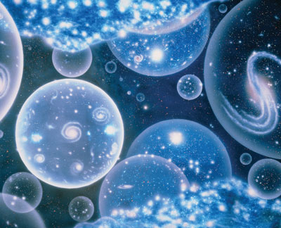
Notes:
So I have taken you on a trip back in time almost to the big bang when the universe was unimaginably tiny, hot and dense. What lies outside; what happened before. I have to tell you that physicists – who know no fear – have answers and they are more philosophically challenging than anything I have said so far. They posit that our universe is just one member of an enormously large number of universes that are happening all the time. This is sometimes called a “multiverse”.

Slide 26

Notes:
When they consider all the different types of universe that might exist, they conclude that very very special conditions are needed for a universe that could last as long as ours has and have the conditions for “life as we know it” to develop. They then turn the problem on its head and say that all types of universe come into being. The overwhelming majority are stillborn. By our very existence we are self-selecting the rare example that allows us to be. This is sometimes called the “Anthropic Principle”. Things were as they were because we are as we are! Think about it! Yes, it is a wonderful and disturbing idea.

Slide 27
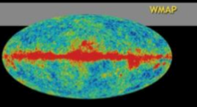
Notes:
What I have told you is a remarkable story. It has been told by astronomers and physicists from many countries using a flotilla of space telescopes. It has been a gloriously successful enterprise marked by technical brilliance, industry and dedication by so many those who work for and with NASA and, lets face it, a parcel of good luck. Whatever your involvement with this enterprise, surely it is something with which we can all be proud. Enduring accomplishment. Scientific discovery to match that of the Greeks and the Enlightenment achieved in decades not centuries. As I have indicated the means is at hand to complete the story, to understand our origins and to know our cosmic fate. I hope that we have the will to match this quest.
Thank you.

