Slide 1
The Accelerating Universe
Roger Blandford
KIPAC
Stanford
Notes:
Day when everyone’s thought’s turn to political, legal and economic philosophy.

Slide 2
Greed is Good?
Extraordinarily high energies
  Zevatrons? >100J at source (~home run)
Most astrophysical sources are conspicuously nonthermal
  U_{CR}/U_{thermal} _{dist} ~e^{E/T}T^{5/2}m_{p}^{3/2}E⁻⁴
Plasmas are collisionless
  CR dominate high energy (and much radio) emission
Observers, tell us where and what;
Astrophysicists must tell us why and how
Cosmic ray( physicist)s are the true Masters of the Universe!
Notes:
Except CMB
Plutocracy vs egalitarianism efficient wealth

Slide 3
“Give me liberty or give me death”
Many acceleration sites preclude escape
Protons – photopion production
  GZK, GRB, Cygnus…
Electrons – radiative loss
  Galaxy, pulsars, jets…
Neutrons - decay
  Sun, AGN
Gamma Rays – pair production
  GRBs, AGN Jets

Slide 4
The Rule of Law?
Three Fundamental Particle Acceleration Mechanisms
Unipolar Induction
  Pulsars, Black Holes, Jupiter, Sun…?
Reconnection
  Solar flares, magnetospheres, PWN?
Shocks
  Supernova remnants, termination shock, clusters…?
Are there general principles which apply in very different locales?
Can we develop a better physical description through comparison?

Slide 5
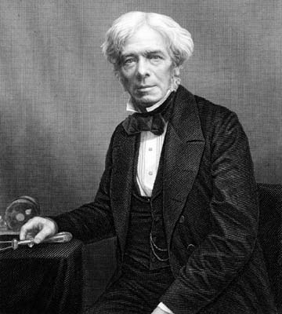
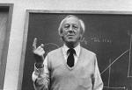
Velvet Revolution?
Unipolar induction by spinning magnetized body
  T
Magnetic field is “lazy”
Ω
Particle acceleration is “ohmic dissipation”
Highest energy particles carry the current?
V ~ Ω Φ ∼ Ε_{max}/e
I ~ (V / Z₀)(c/v)
Z₀~100Ω
P ~ V I ~ (V²/Z₀)(c/v)
Particles gain energy steadily by
moving across potential difference
Φ
Sun – V ~ 100 MV, I~1 GA
GRB – V ~ 0.1 YV, I~1 ZA
Where do currents flow?
Where do they dissipate?
Where do they push?

Slide 6
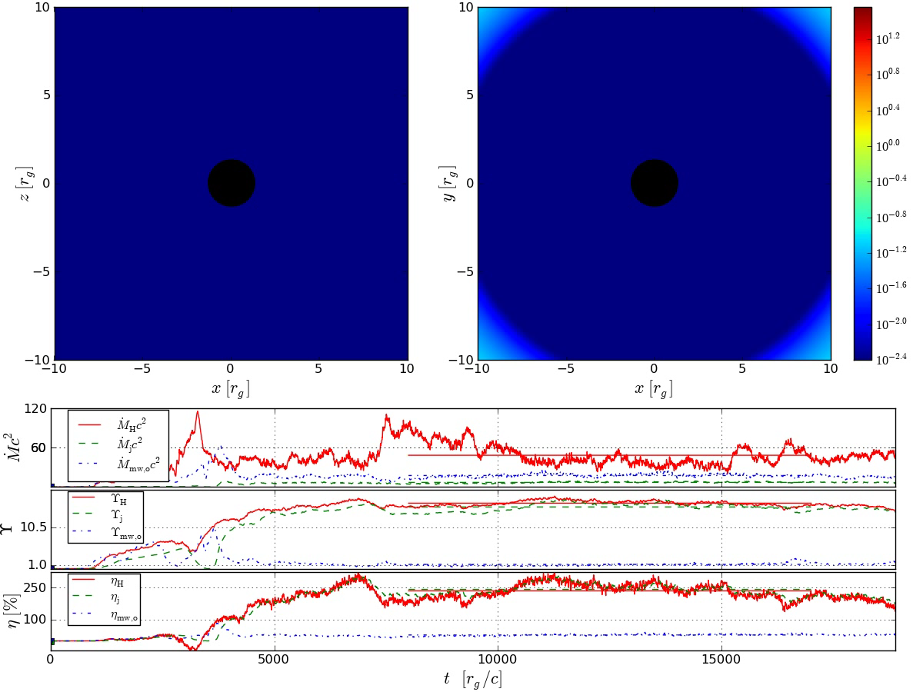
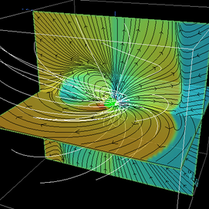
Compute 3D Electrodynamic Models
McKinney
Spitkovsky
McKinney+RB
Billion M_{o} Black Hole
  B ~ 1T; Ω ~ 10⁻³ rad s⁻¹
  V ~ 1ZV; I ~ 10EA
  P ~ 10³⁹W
1 M_{o} Neutron Star
  B ~ 10MT; Ω ~ 100 rad s⁻¹
  V ~ 30 PV; I ~ 300TA
  P ~ 10³¹W
Wilson
Learning much about basic physics from numerical experiments

Slide 7
(Re)connection
cf (re)heat, (re)combine, (re)ionize!
In a big flare, V>vBL is possible
  High energy particles
Liberated magnetic energy -> KE mostly
  May form shocks
Details depend on anisotropic σ, P
  Hall effects vindicate Petschek mechanism
  Waves, dynamics, stability quite different
Acceleration efficiency is low unless there are multiple current sheets ?
  What happens relativistically?
Affordable Acceleration?
Notes:
Re

Slide 8
Macro and Micro
Fluid description
  P, ρ, v, B…
  Magneto Fluid Dynamics
    Flux-freezing, conservation of mass, momentum, energy
    P ~ ρ^{γ} − isotropic!
  Relativistic flows
  Electromagnetic Flows
Kinetic description
  f(p,x,t), E, B…
  Collisionless plasmas
    Vlasov equation for f
  Nonthermal distributions
  Transport effects
  Ultrarelativistic plasmas
Need a hybrid approach
to tackle global problem

Slide 9




Particle drifts and current
Normal approach is to analyze particle orbits and deduce currents
Can also start from static equilibrium and understand what is happening
Curvature perpendicular magnetization gradient ExB
Orbit, fluid approaches to Ohm’s law perpendicular to field are identical
Parallel current requires additional physics eg wave-particle scattering
A closely related approach is double adiabatic theory
Complete?
Incomplete?

Slide 10
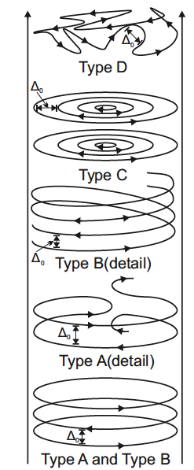
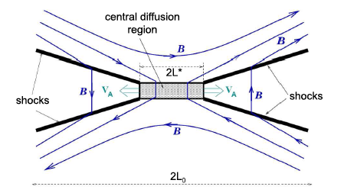
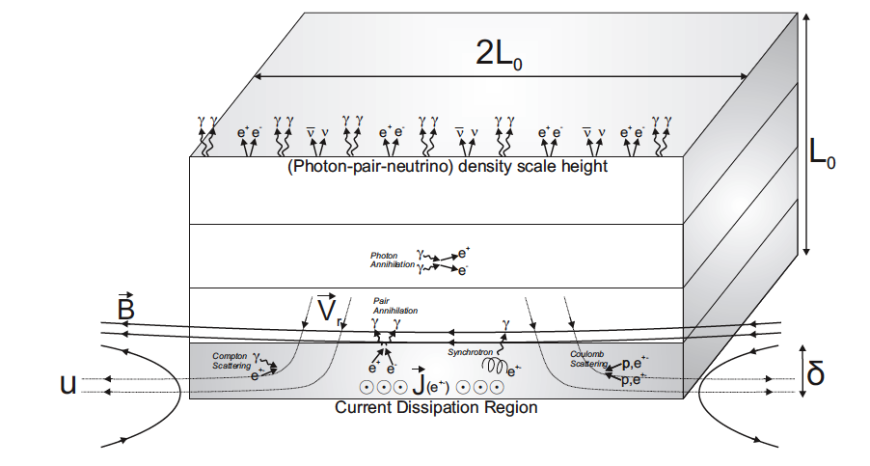
“Only Connect”
Pinch
Non-relativistic
Petschek
Relativistic
Cerutti et al
McKinney &Uzdensky

Slide 11
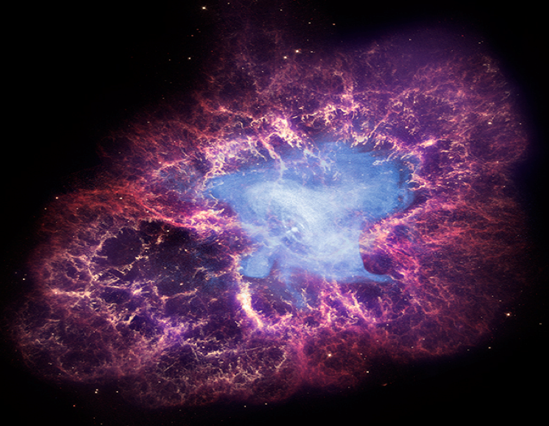
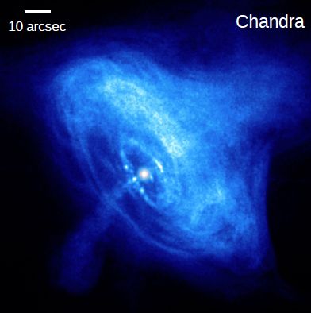
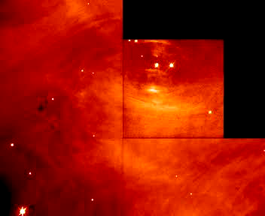
Crab Nebula

Slide 12
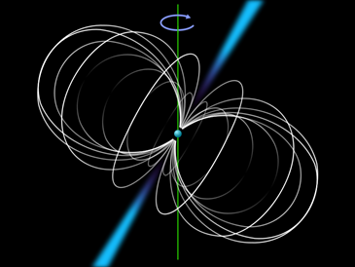
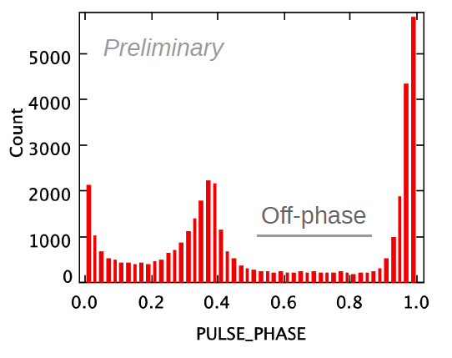
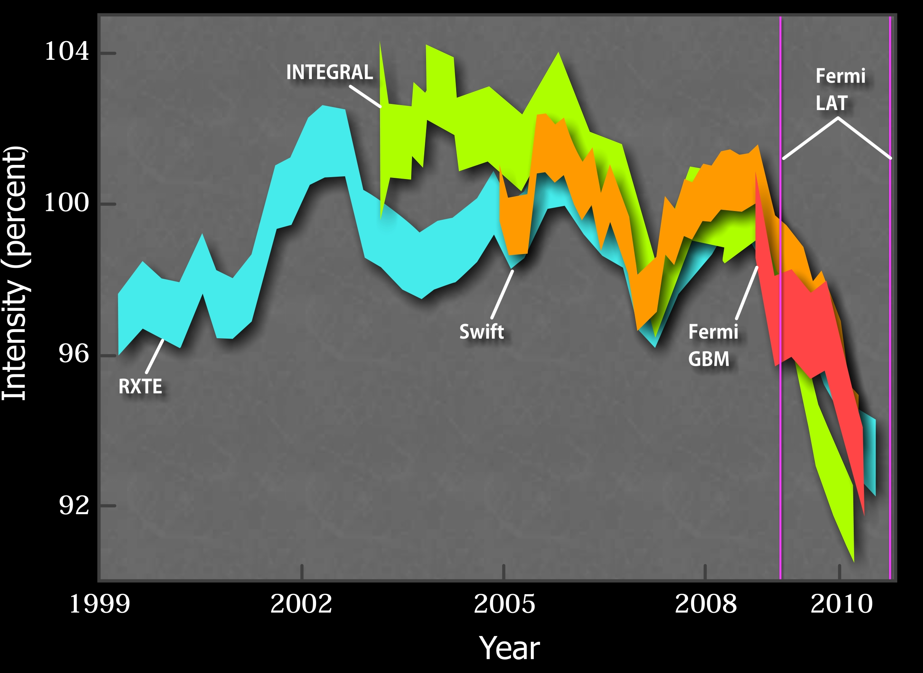
Crab Pulsar
Discovered in 1968
  Turning point in history of astronomy
  Predicted by Pacini
Spinning, magnetized neutron star
  12km radius
  30 Hz spin frequency
  200 MT (2x10¹²G) surface magnetic field
  Radio through > 100 GeV γ-ray pulsation
Giant electrical generator
  ~ 50PV; 200TA; 2x10³¹W ~ -IΩΩ’
  Powers nebula; large energy reservoir
  Deceleration due to Maxwell stress applied to surface
    Equivalently Lorentz force as j x B in star
  Fate of EM energy and angular momentum flux?

Slide 13
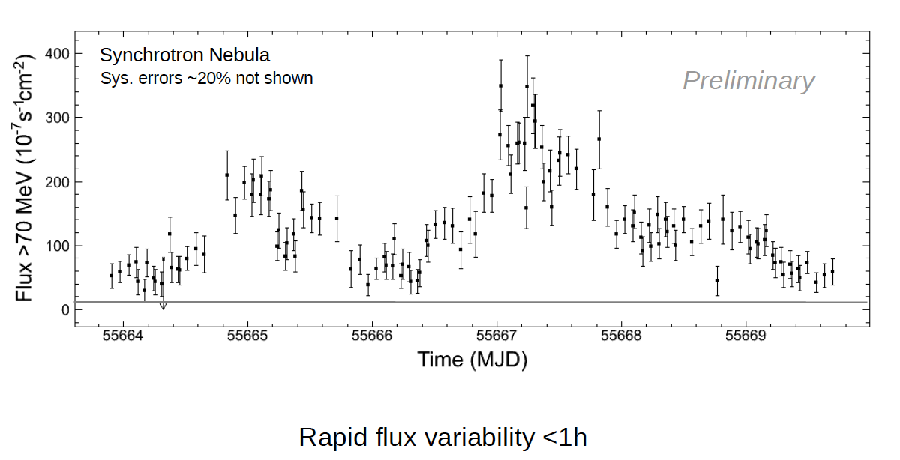
Flaring behavior
Buehler et al
April 2011
Power~10²⁹W
Singular events or power spectrum? No variation seen in other bands

Slide 14
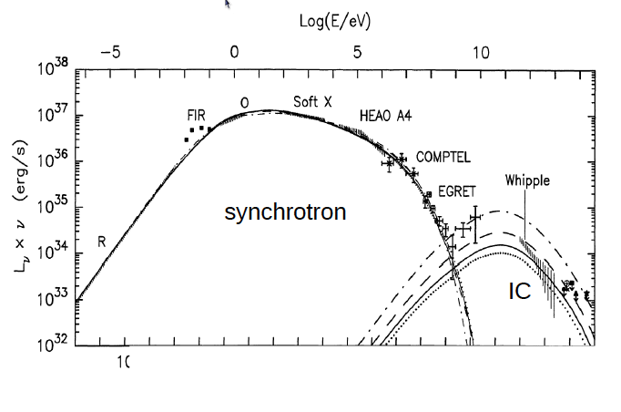
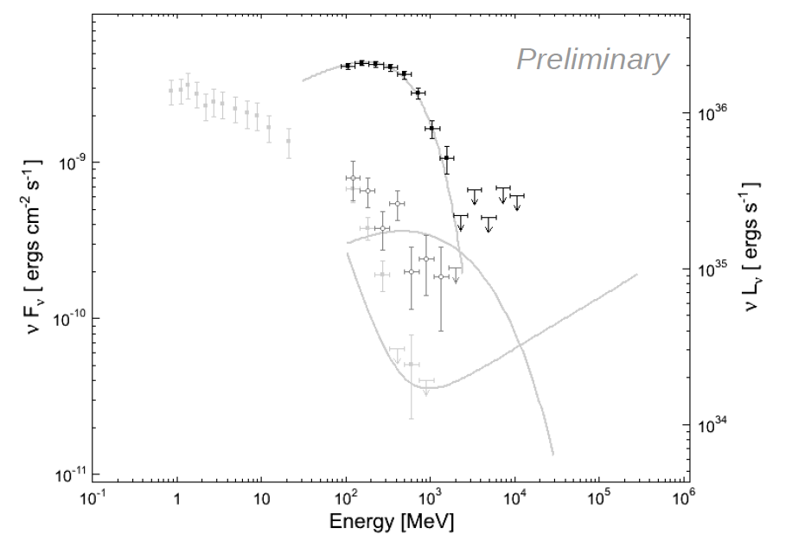
Electrodynamical implications
Electron synchrotron radiation: γ~10⁹; B~100nT; Eγ ~ 300 MeV
If E<B, photon energy < 70 MeV; 300 MeV observed!
Peak power ~ 0.03 total nebula power!
Isotropic flare energy requires region ~ 20 lt days across!
=>Relativistic beaming?
Model for extreme acceleration in AGN jets?

Slide 15
Extreme particle acceleration?
We want to learn where and how nature accelerates particles to high energy
Not the Pulsar
  No correlation with rotation phase
Wind shocks when momentum flux equals nebular pressure
Wind, Shock, Jet, Torus are all possibilities
=10,000mas
W
P
J
S
T
1 lt hr = 3 mas
Larmor radius= 60γ₉B₋₇⁻¹mas

Slide 16
Feeling the pinch?
Resistance in line current
  Current carried by high energy particles (not thermal proletariat)
  Resistance due to radiation reaction
  Pairs undergo poloidal gyrations which radiate in all directions
  Relativistic drift along direction of current - Jet!!
  Compose current from orbits self-consistently
  Illustration of Poynting’s theorem!
  Variation intrinsic due to instability
E
j
X
B_{φ}
r

Slide 17
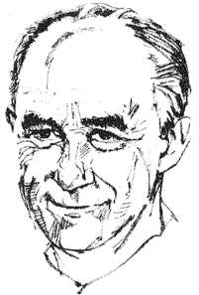
Stochastic Acceleration
Random and steady terms
First and second Order?
Fokker-Planck equation
cf Black-Scholes equation!
U
ΔE/E ~ +/-u/c
ln(E) ~ u/c (Rt)^{1/2}
c
Diffusive shock acceleration
Observe in interplanetary,
interstellar media
Much more complicated
  mediation
  escape
  time-dependence
Energy and Persistence Conquer All Things (Franklin)
Notes:
Ben Franklin
Currency
Black-Scholes

Slide 18
Égalité, Fraternité, Liberté
Injection out of thermal plasma
  Depends on mass
Cosmic rays act collectively to create scatterers
  Bootstrap mechanism
What we measure depends crucially upon escape and propagation which is a function of rigidity
  Heliospheric termination shock is best laboratory
  Propagation could depend on sign of charge reflecting wave spectrum
    Positrons slaved tp protons which diffuse slower than electrons?
Cosmic ray data are improving rapidly
Notes:
Jacobins
Emission transmission

Slide 19
Magnetic Bootstrap
Alfven waves scatter cosmic rays
  λ ~ several r_{L}(E)
  D ~ cλ/3; L ~ D/u > 100 E_{PeV}B_{μG}⁻¹Z⁻¹pc
  Requires magnetic amplification; B > 300 μG
  Highest energy cosmic rays stream furthest ahead of shock
  Distribution function is highly anisotropic and unstable
  Conjecture that magnetic field created at radii ~ 2R by highest energy escaping particles
  Cosmic ray pressure dominates magnetic pressure here
  Lower energy particles transmitted downstream
  Magnetic field created upstream and locally isotropic
0.1
P(E) / ρu²
P(E) / ρu²
E
Shock
GeV TeV PeV
PeV
TeV
GeV
X

Slide 20
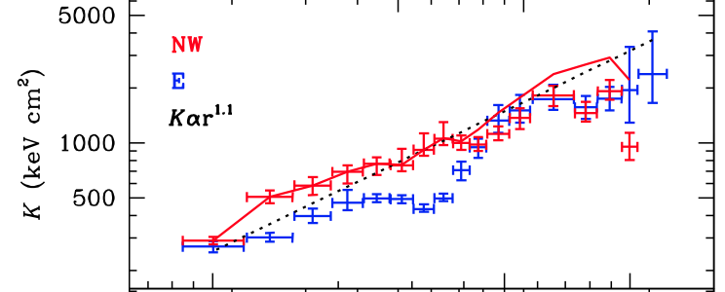
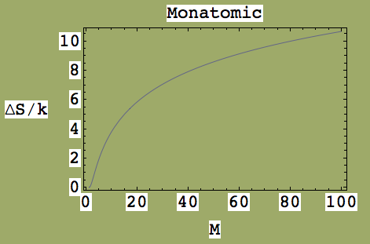
Cluster accretion shocks
S_{gas}/k
Simionescu et al
Perseus cluster
18
Measured entropy in outer parts of clusters is much greater than gas entropy after reionization
  ΔS > 10 k?
Requires strong accretion shock
  Arise in simulations
  M can be as large as 100
A candidate site for UHECR acceleration
  Needs to be Fe!
  Also jets, GRBs, milliscond magnetars
17
16
15
14
13
r
r

Slide 21
Что делать
Unipolar Induction
  Current closure, Crab pulsar wind, jets, BH imaging
Reconnection
  Experiment, observation, simulation
Shocks
  Termination shock, supernova remnants
  Chandra, JVLA, NuSTAR!
  Propagation
ν messengers, detectors…

Slide 22
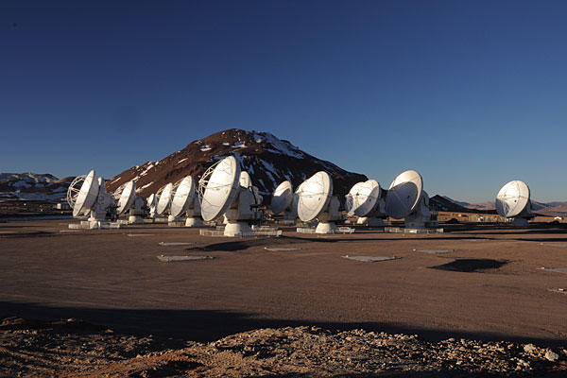
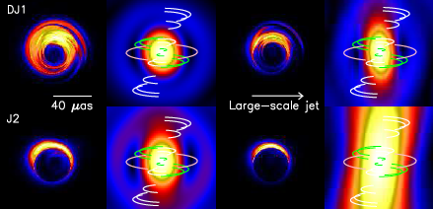
Imaging a Black Hole?
For M87 and Galactic Center,
  2m ~10μ arcsec ~ 300μ/R_{E}
Event Horizon Telescope (Doeleman et al)
  ALMA VLBI
Dexter, McKinney, Agol
ALMA

Slide 23
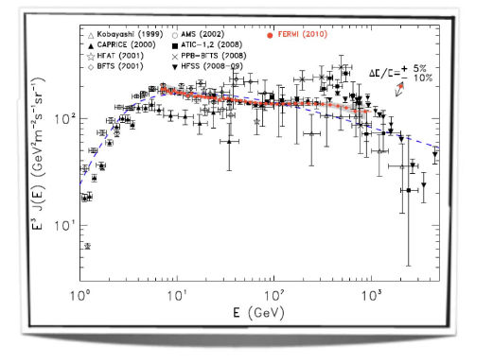
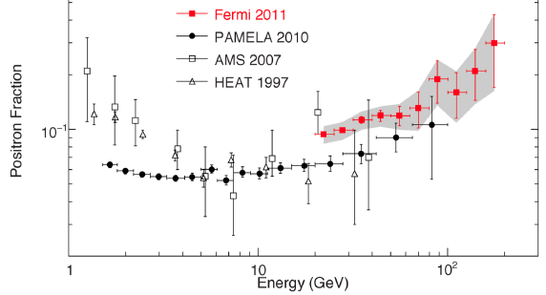
The Accelerating Universe
Cosmic ray physics is the mother of particle physics
  Positron, pion, muon, kaon
Dark matter may be identified below, on or above ground
  Exciting race
Many new cosmic ray investigations
  Information rich field with rich discovery potential

