Slide 1
The Crab Impact
Roger Blandford
Yajie Yuan
KIPAC
Stanford

Slide 2
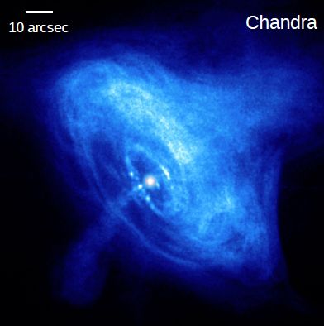
Wind, Shock, Jet, Torus (not Pulsar)?
Pulsar:
  Φ~50PV, I ~ 200 TA;
  L_{EM} ~ 10³⁸ erg s⁻¹ ~ 0.3 L_{neb}
Nebula:
  U~ 3 x 10⁴⁹ erg; B_{eq}~0.3mG
  3 M_{sun} filaments
Wind:
  B~0.3(R/r)σ^{1/2} mG
  Striped? Dissipation?
  Relativistic beaming/sector structure vs power
  L/L_{EM}<ΔΩ/4π<t_{var}/100d in flow model.
    Hard to satisfy!
Ring/Shock?:
  R~ 100 lt d ~ 2 x 10⁹ R_{lc}
  Current Sheet? Dissipation?
Jets
  >0.1 R?, B~0.3(R/r)Ι₁₄ mG
  Pinch? Dissipation?
=10,000mas
W
P
J
S
T
1 lt hr = 3 mas
Larmor radius= 60γ₉B₋₃⁻¹mas

Slide 3

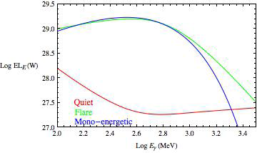



Flare Electrodynamics
0.01L_{neb}
t_{var}~1-10hr
High energy particles carry the current?
Electron “synchrotron” radiation in uniform B
  Ε~2B₋₃^{-1/2}PeV; N_{e}~4 x 10³⁸(ΔΩ/4π); U_{e}~10⁴²B₋₃^{-3/2} erg;
  r_{L}~3B₋₃^{-3/2} lt d; t_{cool}~12B₋₃^{-3/2} hr ~ 12º
  Compensate loss with E||~140Vm⁻¹~9B₋₃^{-1/2} PVr_{L}⁻¹~ 5B
  (U_{e}/3P_{neb})^{1/3}~B₋₃ r_{L}; (U_{f}/3P_{neb})^{1/3}~10B₋₃ r_{L} if isotropic
  t_{var} > 1 d!

Slide 4
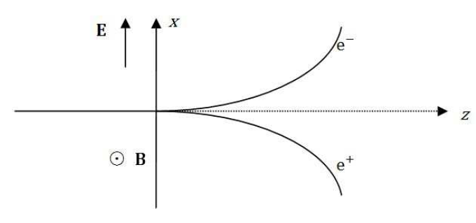

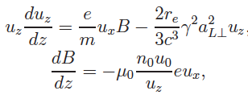
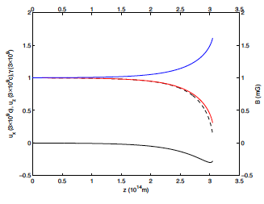
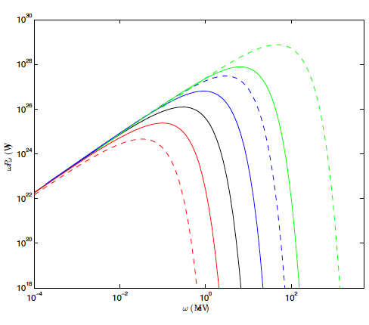
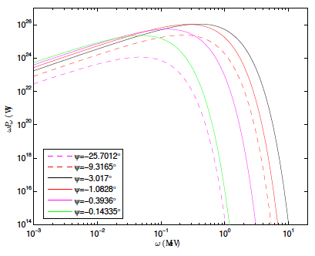
Radiative shocks
σ=1
No reflection; downstream dissipation
γ₉=3; B=1mG
Planar, cylindrical, ellipsoidal shocks
Time-dependent shocks
Relativistic shock motion
Receding brightest
Understand kinematics
σ=100
Spherical
Moving
σ=100
Cylindrical
Angle

Slide 5




Particle drifts and current
Normal approach is to analyze particle orbits and deduce currents
Can also start from static equilibrium and understand what is happening
Curvature perpendicular magnetization gradient ExB
Orbit, fluid approaches to Ohm’s law perpendicular to field are identical
Parallel current requires additional physics eg wave-particle scattering
A closely related approach is double adiabatic theory
Complete?
Incomplete?

Slide 6
Pinch Equilibrium?
Resistance in line current
  Current carried by high energy particles
  Resistance due to radiation reaction
  Pairs undergo poloidal gyrations which radiate in all directions
  Relativistic drift along direction of current - Jet!!
  Compose current from orbits self-consistently
  Illustration of Poynting’s theorem!
  Variation intrinsic due to instability
E
j
X
B_{φ}
r

Slide 7
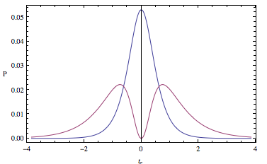
Formalism
r
ξ
dusk
x(τ), u, a, j
1D Jerk
P_{em}
t
Take limit to demonstrate
energy flow.
dawn
P_{res}
Notes:
Galt’sov & Spirin

Slide 8
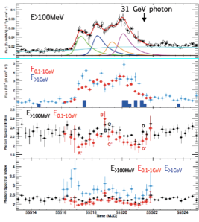
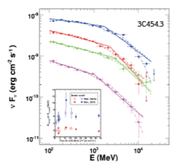
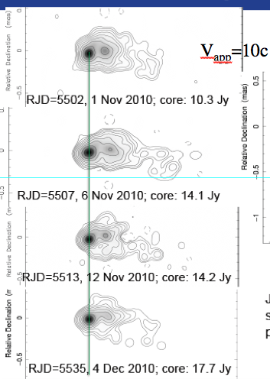
Broader
Marscher
2x10⁵⁰erg s⁻¹ isotropic
Breaks due to recombination radiation?

Slide 9
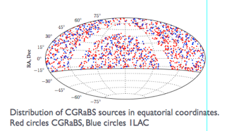
Radio Monitoring (OVRO 40m)
~1500 sources
Radio and γ-ray active
Spectrum, polarization
Max-Moerbeck etal

Slide 10
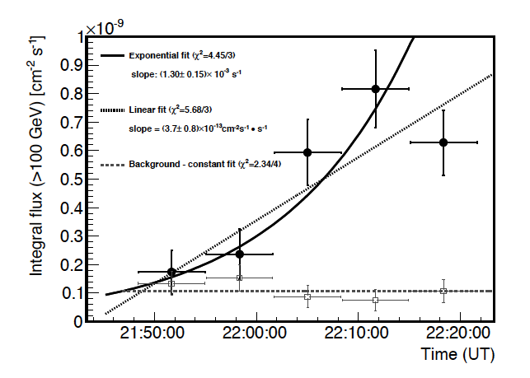
Rapid MAGIC variation
PKS 1222+21
  10 min
MKN 501
  5 min
PKS 2155-304
  2 min Aharonain (Aharonian
PKS 1222+21 (Aleksik et al)
How typical?
How fast is GeV variation?

Slide 11
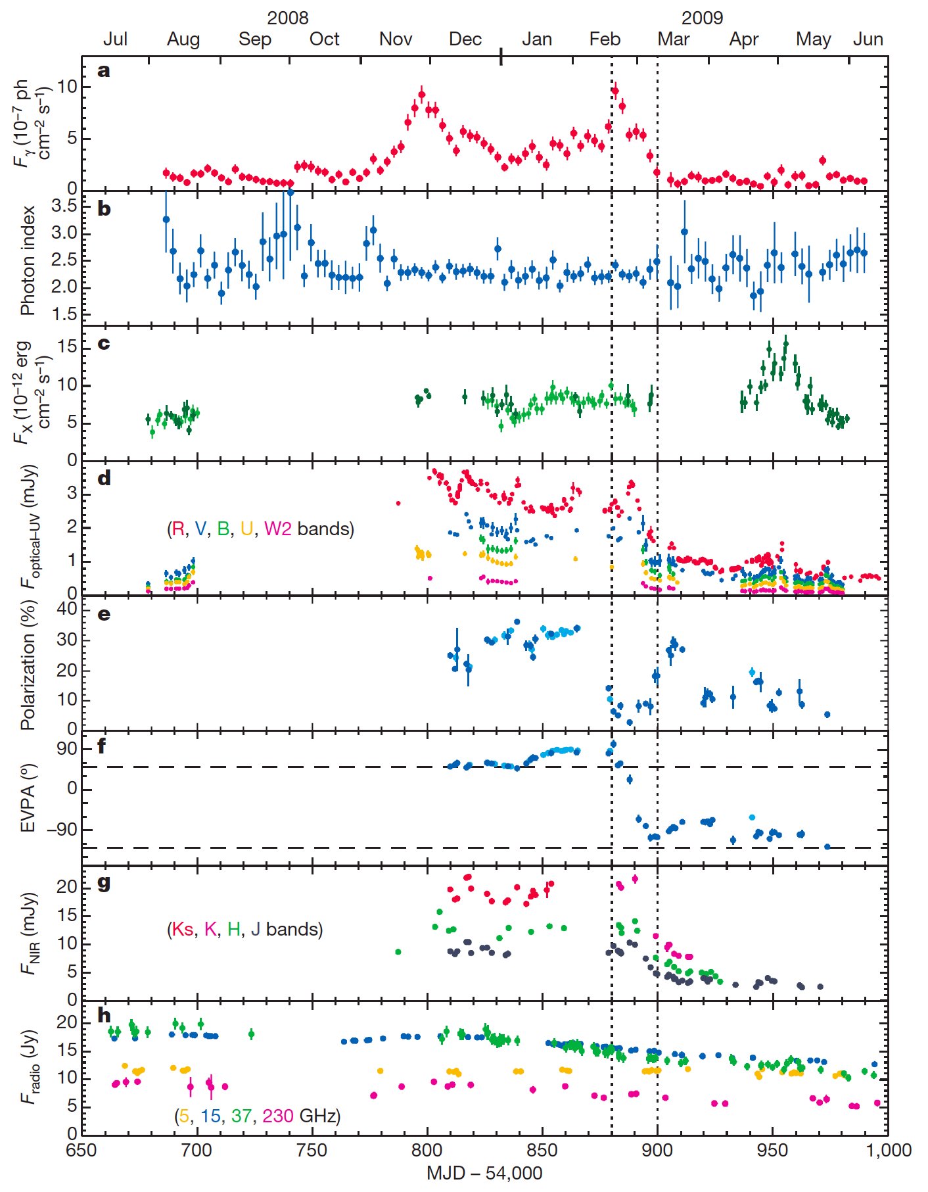
3C 279: multi-λ observation of γ-ray flare
~30percent optical polarization => well-ordered magnetic field
τ~ 20d γ-ray variation
=> r~γ²cτ ~ pc or τ_{disk}?
Correlated optical variation? => common emission site
X-ray, radio uncorrelated => different sites
Rapid polarization swings ~200º => rotating magnetic field in dominant part of source
r ~ 100 or 10⁵ m?
Abdo, et al Nature, 463, 919 (2010)

Slide 12
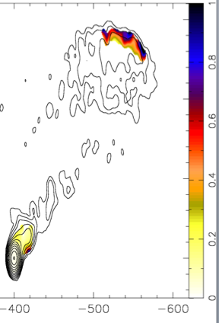
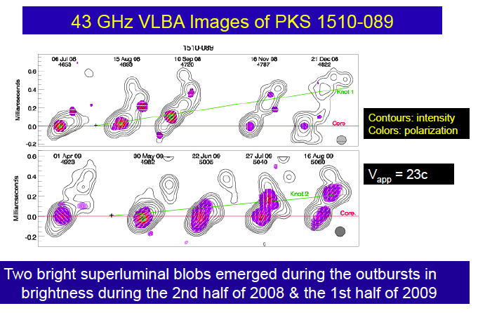
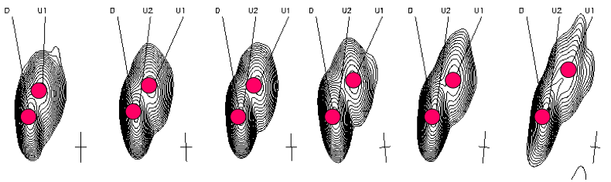
PKS1510+089
(Wardle, Homan et al)
β_{app}=45
Rapid swings of jet,
radio position angle
High polarization
~720º (Marscher)
Channel vs Source
TeV variation
(Wagner / HESS)
EBL limit
r_{min} ; r_{TeV}>r_{GeV}
(B+Levinson)
z=0.36

