Slide 1
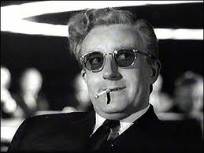
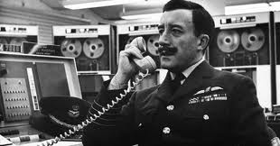
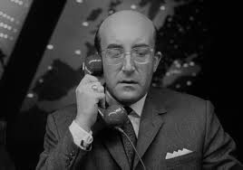
“How I learned to stop worrying and love cosmology”
Roger Blandford
KIPAC
Stanford
Notes:
Did not choose.
Which character?
Impressionistic view

Slide 2
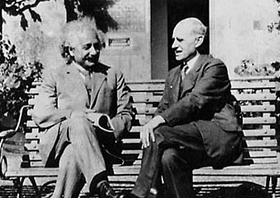
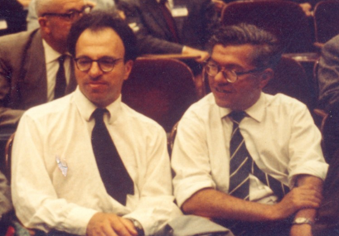
  “A theory is something nobody believes, except the person who made it. An experiment is something everybody believes, except the person who made it.”
  “I would as soon think of reverting to Newtonian theory as of dropping the cosmical constant…to drop the cosmical constant would knock the bottom out of space”
  ~Most of the observations in cosmology are wrong, so I shall ignore them
  “Big Bang”
1917
n=1-2φ
1919
1952
3H²=8πGρ
1948…
Notes:
Expt –th now inverted
Much was anticipated especially theoretically the progress in observation,
Eclipse expedition
Universe older than content; provides scale
Birmingham Technical Lib
Unintended consequence
Same geo kins

Slide 3
Cosmology is a Competitive, Cooperative and Collaborative Concern
Tribal chauvinism
  Spectral, technique, telescope…
  Sometimes correct!
  Exacerbated by large collaborations
CMB is special
  50 years exquisite development of observational technique
  Physics-based not empirical unlike most other approaches
  Growth, radiative transfer at recombination are linear
However,
  Ill-suited to curvature, acceleration…; other approaches better
  Astrophysical foregrounds are important for current challenges
  Results will not be accepted without validation
The case for multiple approaches is stronger than ever
  Not just the bottom line; data-rich science
  Detailed cross correlations and checks improve all approaches
  Cosmology benefits all other investigations using same data set
Notes:
Meeting about need to combine probes
Natural human tendency tribal loyalty and to treat other tribes with suspicion and dismiss their culture
Sometimes warranted eg creationism, flood geologist. Antediluvian
700 - 1200
Sometimes approaches have run their course and been displaced eg planetary nebulae as SC
Can be painful if you have spent ten years perfecting a technique
As well as progressive nature of science there is the peculiar business of astronomy
Mathematics/particle physics prime numbers, masses, spins…
Sociologists classify people some early type, late type and spheroids
Red galaxies parents seen by teenagers?
Problem is not that the universe is wayward but we can’t solve problems of 19c physics
Cosmology is in between
Cosmologists are often in error, though never in doubt Lev Landau
Where is cosmology today?

Slide 4
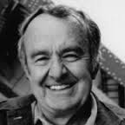
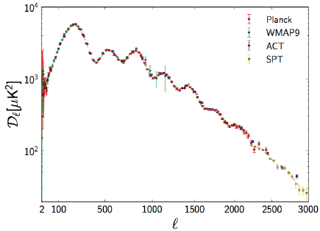
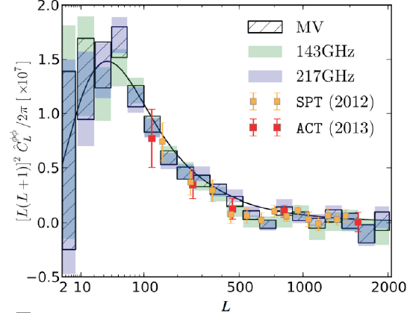
Just 6,7,8…1006 numbers?
FΛCDM
  Ω_{dm}h² => Ω_{dm} ~ 0.27
  Ω_{b}h² => Ω_{b} ~ 0.05
  Θ∗ => H₀ ~ 68
  τ => z_{1/2} ~ 11
  n_{s} => 1-n ~ 0.04
  A => Φ ~ 10⁻⁵
No convincing evidence for:
  Curvature (<0.01)
  Dynamical dark energy (<0.1)
  Extra neutrinos; neutrino mass (<0.2 eV)
  Non-Gaussianity (f_{NLlocal} < 6)
  Tensor modes (<0.1)
Gratton
Dunkley
Ho
Lahav
Notes:
Allan was Godfather of enterprise
Planck long heritage SPT, ACT l ~ 3000; lensing

Slide 5
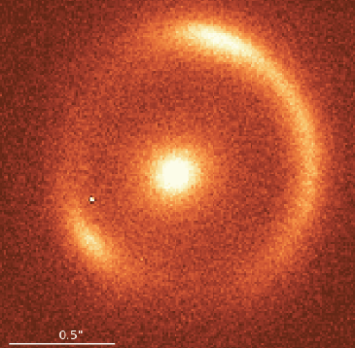
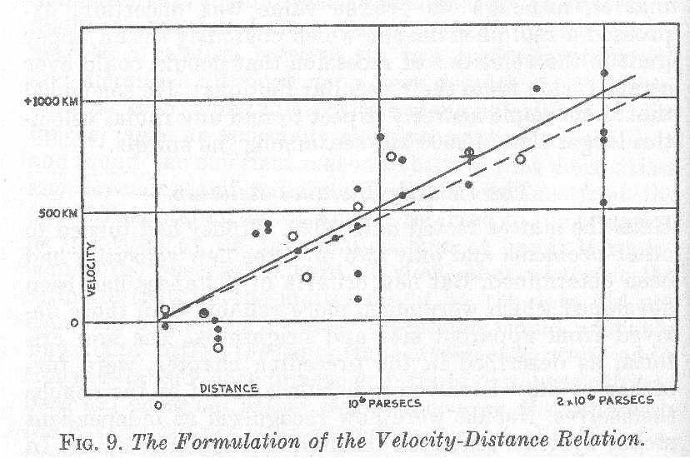
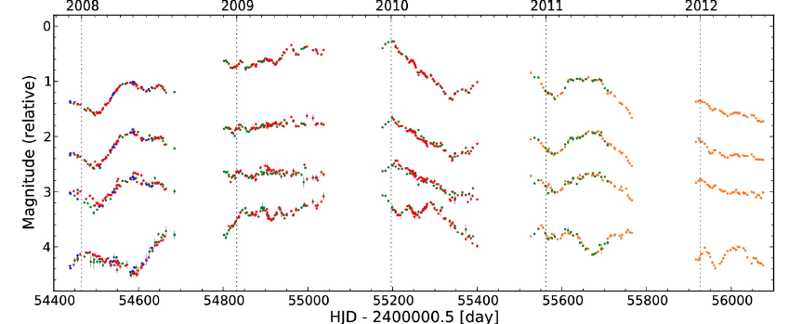
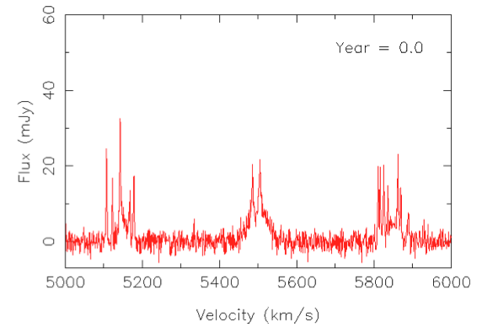
Hubble Constant
The Realm of the Nebulae (Edwin Hubble)
Approaches
  CV, EB, GL, MM, RR, SN, TR…
  Many old methods no longer used
  3-5% uncertainty is GOOD!
  Planck “tension” overstated
Highlights
  IR Cepheids, local SN calibarators, z=1.9, MM MW parallax, dust, RR, AO, lens modeling, delays
Prospects
  MM, GL looking at many more sources
  Test detailed modeling ansatzen
Goal is 1 percent uncertainty
  Astrophysical modeling and propagation
Freedman
Robeson
Kirshner
Braatz
Gratton
Riess
Fassnacht
Suyu
Kowalski
Benoit-Levy
Tamman
Leibundgut
Notes:
Sins of emission and transmission
Goal attainable

Slide 6
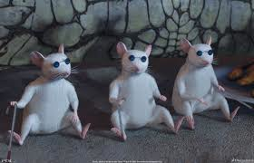
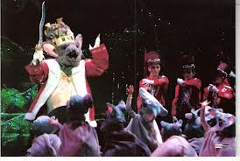
In the world of the blind, the one-eyed mouse is king.
L
X
h
P
Confirmation/Refutation/Gudenuf bias
Blinding is idiosyncratic to technique
  Withhold data fraction, calibration, compete teams…
Must not impede understanding experiment
Most experiments in practice are partially blind
  Particle physicists especially
    However usually do not make data public!
    Cross correlation of details much more common in astronomy
Will become common practice in cosmology
  Essential for acceptance by physicists and astronomers
Notes:
Cosmologists are often in error but never in doubt

Slide 7

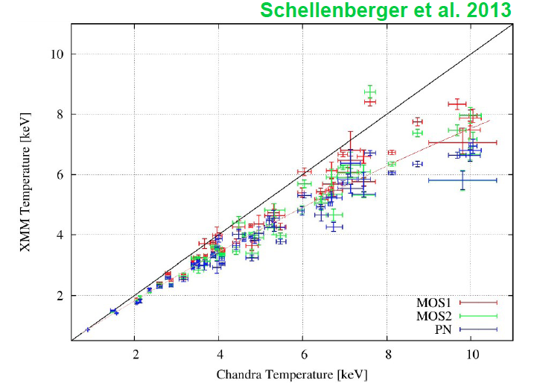
Dark Matter
Use of potential
  Linear
  Add second potential (ν shear stress) perturbatively
ISW
  Is this still useful? Cross-correlation?
Clusters
  Historically reliable
  Intermediate radii of relaxed clusters-> f_{gas}
  Need mass proxies, temperature scale
    May resolve Planck SZ discrepancy?
Bartelmann
Aghanim
Douspia
Zhang
Allen
Notes:
General equation makes it easy to see what must have happened.
Clusters lime SN1a unreasonably reliable

Slide 8
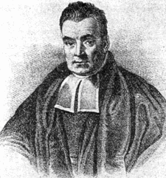
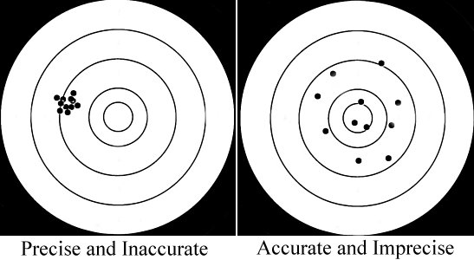
Statistics:“Grammar of Science” or “Theory of Ignorance”
Precision Cosmology and/or Accurate Cosmology
Bayesian methods typically used in most investigations
Particle physicists use frequentist methods
More science like astronomy
MCMC methods - unmodeled systematics?
  Control loops?
Perhaps some investigations
will start to resemble
particle physics…
Notes:
If your experiment needs statistics, you ought to have done a better experiment-Ernest Rutherford.
Employment for astronomers
MCMC do not include unmodeled systematics.
Imprecise use of precision
Thomas Bayes was the son of Presbyterian minister in Tunbridge Wells near London
He was born in 1701 and educated in theology and logic
He followed his father into the Presbyterian church.
By all accounts, he was a hopeless preacher.
This is the only known picture of him and I read that it is probably of someone else so one has to perform a Bayesian analysis to figure out what he looked like.
Presbyterianism is a dissenting sect that rejects the authority of Rome and Canterbury.
I know because I was brought up in this tradition.
His publication list had two entries, a Panglossian essay on Divine benevolence and a defence of Newton’s fluxions against an attack by Bishop Berkeley
He died in 1761 and one of his friends published some mathematics from his notebook posthumously in Phil. Trans. Roy. Soc. In 1763 - An essay towards solving a problem in the doctrine of chances
His theorem relating the posterior to the likelihood, the prior and the evidence (in modern language) was stated to deal with “real” problems like what can you learn about the contents of an urn containing colored balls when you withdraw some balls from it at random.
I think he would be surprised by where his line of reasoning has led.
I am not sure if Bayes would have been a Bayesian.

Slide 9
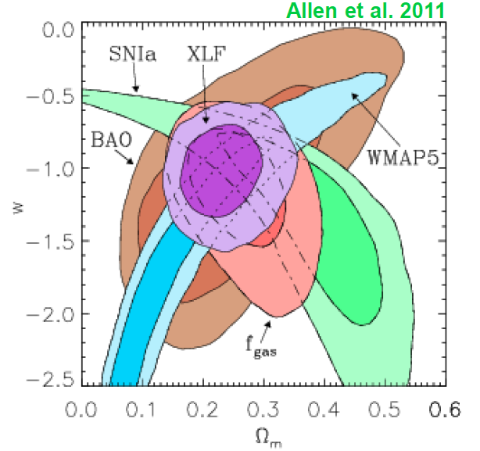
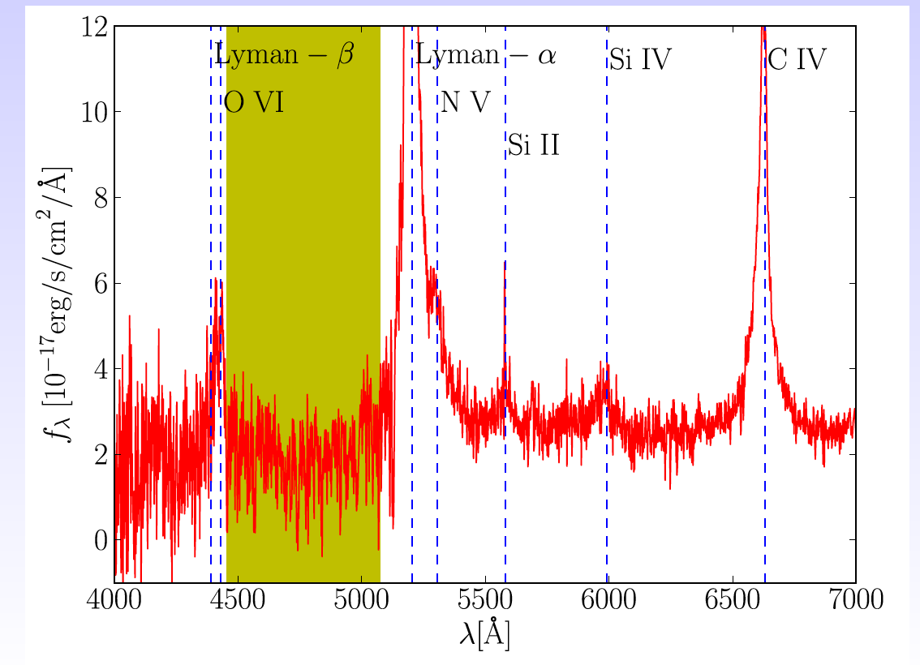
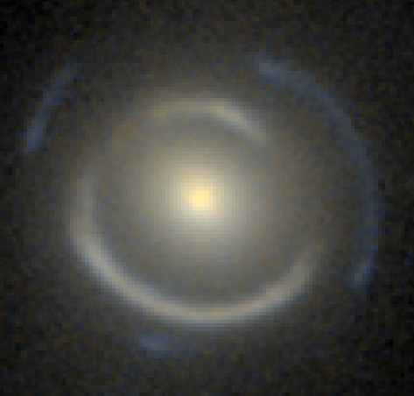
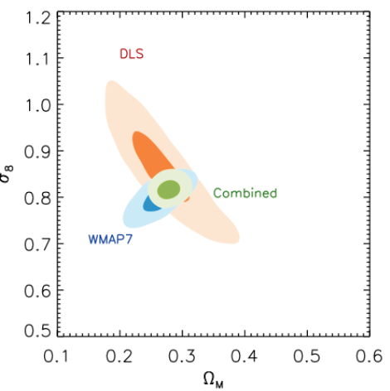
Dark Energy
FΛCDM… is null hypothesis?
  Seek deviatiosn perturbatively now
  Kinematics j=a’’’a²/a’³ =1 => t(a)
  Growth of structure: γ(a)=6/11
Many measurements
  Planck, BOSS
  X-ray clusters δw ~ .05; δγ~0.1
  Jackpot lens
  Viel: WDM > 3keV?
  WL tomography
Systematics
  BAO best?
  CHIME?
How well will WL perform
  What is realistic value of l_{max}?
Kneib
Newman
Kazin
Collett
Davis
Refrigier
Slosar

Slide 10
Dark Energy Theory
Quantum mechanical view
  Everything derivable from QFT in principle
  Dark energy is likely manifestation of the vacuum
  Observed behavior suggests (hyperfine-tuned) scalar field => P, ρ
  Restrictions on Lagrangian density; w > -1, H bounded below
  Inelegant generalizations
Neo-classical view
  Classical physics/continuum approximation appropriate on intermediate scales
  On small (atomic, nuclear, particle) scales need h…
  On large (cosmological) scales need Λ, …
  GR suggests universal ie ubiquitous and eternal Λ
  Inelegant generalizations to GR and Cosmology
Amendola
Notes:
W is NOT an equation?
Landscape gardners
Trisderivaphobia
Smart money on FLCDM
However, none of this removes need to measure

Slide 11
Neutrinos
Neutrino oscillations
  Σm> 0.06eV (>0.09eV, if inverted)
KATRIN
  Capable of measuring electron neutrino mass to 0.2eV
BAO
  <0.15eV? (WiggleZ)?
X-ray Clusters
  <0.3eV
Allen
Reiprich
Davis
Notes:
KATRIN has big money behind it.

Slide 12
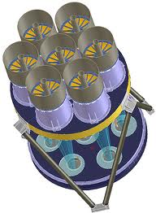
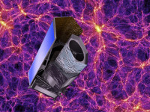
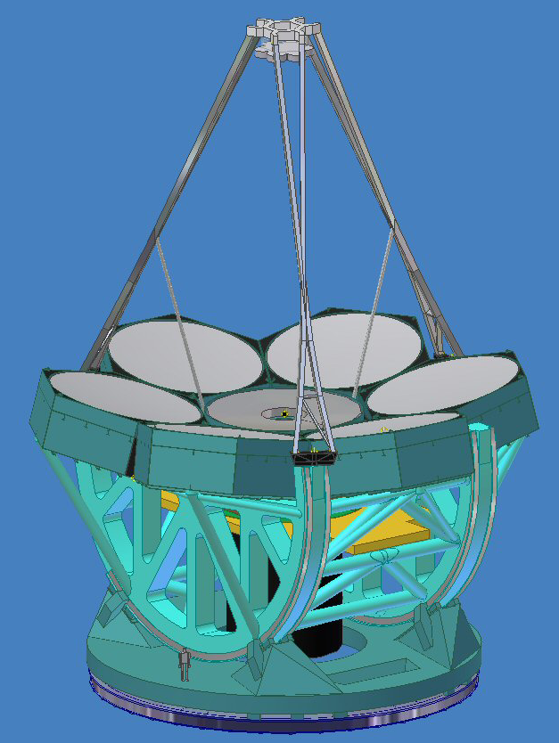
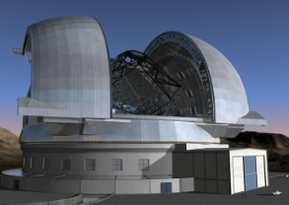
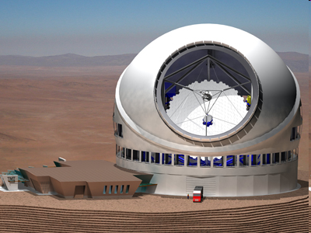
Future Prospects
Many new surveys
  DES, KIDS, eBOSS, HSC, DESI….
Many more of sources
  AGN, G, GL, Lya, MM, SN
Euclid, LSST, WFIRST…
GAIA, JWST…
E-ELT, GMT, TMT
Astro-H, e-Rosita
Keck Array, EBEX…
Mellier
Notes:
Not CMB
Newman: LSST DESY 30million spectraLSST to i=25.3 photo z training
Move to south 3000 sd – south and 20000

Slide 13
Is this the (Beginning of the) End of Cosmology?
Size, shape, age, content… increased accuracy?
  ~ 0.01 upper limits j-1, w+1, r, 11γ-6…?
  3 concordant neutrino masses
  Cold dark matter but no direct or indirect detection?
Particle physics facing similar prospect
  Higgs completes standard model, neutrino sector completed soon?
  No new physics – susy, extra d, (in)direct detection…?
  If so, insufficient justification for expensive new accelerators?
  Astrophysics opportunities: DM, baryogenesis, inflation, σ …
Narrative history of galaxies, nuclei, stars, planets
  EOR onward, descriptive, phenomenological, simulation
Unscripted discovery is highly likely
  Physics, cosmology and astrophysics
Notes:
No one wishes this on PP.
Optimistic about cosmology because:
Br3illiant success at appointed task is about the worst that can happen
Thanks for invitation
Learned a lot and as this summary demonstrated I have a lot to learn.

Slide 14
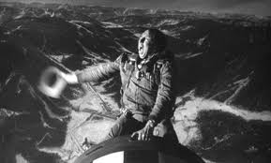
Notes:
We’ll meet again …
Bonnes Voyages dans l’Universaire et la Terre.

