Slide 1


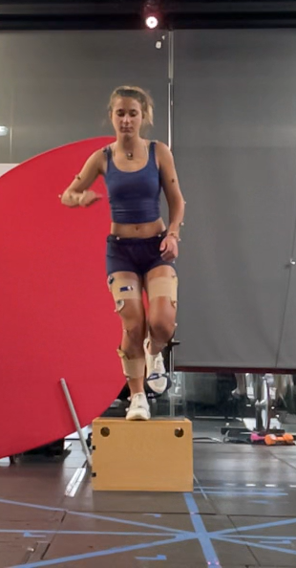
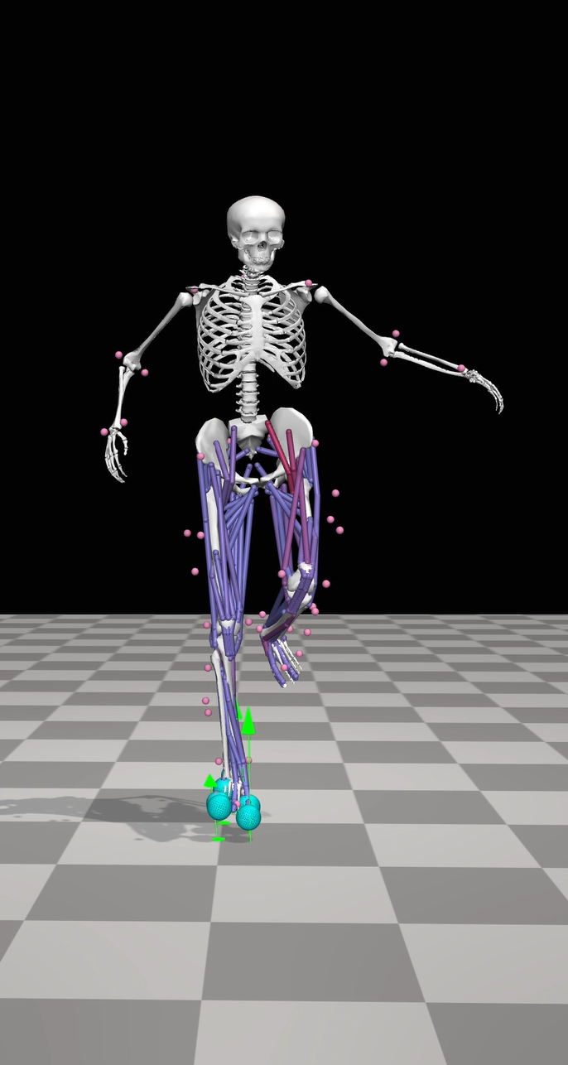
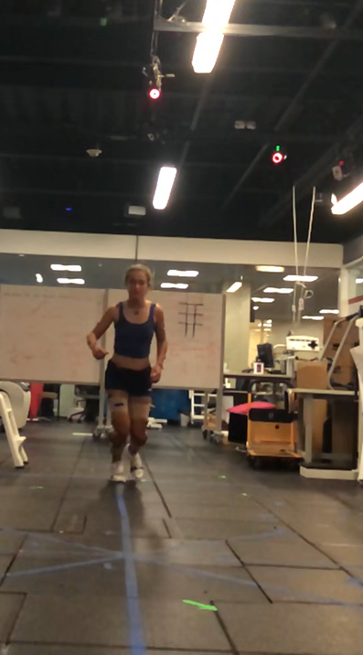
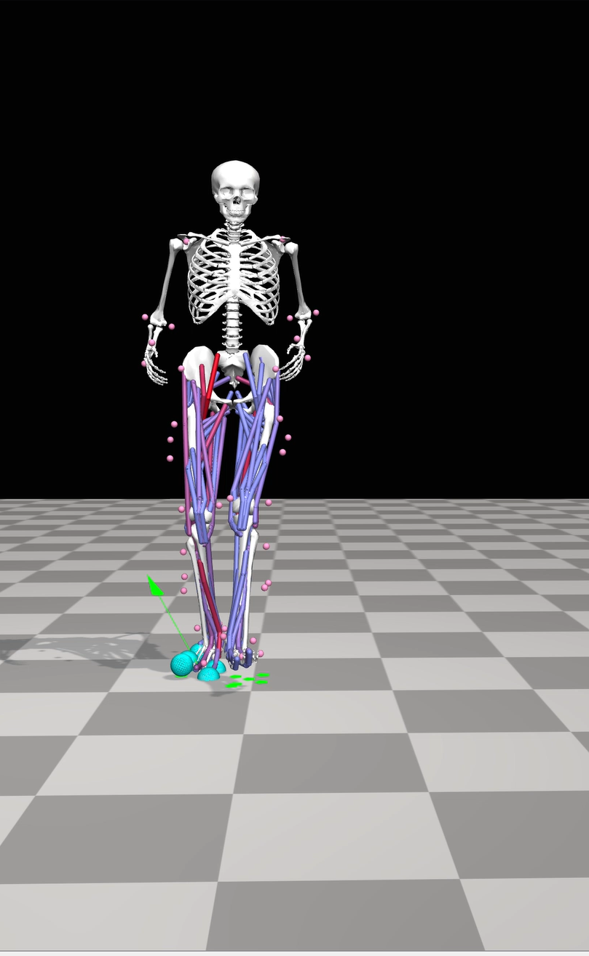
Rapid Musculoskeletal Modeling with OpenCap Transforms Smartphone Videos into Personalized Analysis in Minutes
Single Leg Drop Jump
Run Cut 90°
Notes:
Click once on the slide to begin the first video. Each subsequent video will play in sequence from left to right. Videos will loop until they are stopped.

Slide 2
Summary of the ACL Injury Risk Factors for the two AIR Screening Activities
Body Segment & AIR Subscore | ACL Injury Risk Factors for Single-Leg Drop Vertical Jumps & 90-degree Run Cuts
Trunk | Peak Trunk Lean Angle
 | Trunk Flexion Angle at Initial Contact
Hip | Hip Flexion Angle at Initial Contact
Knee | Peak Knee Flexion Angle
 | Knee Valgus Angle at Initial Contact
 | Knee Valgus Moment at Initial Contact
Foot | Ankle Plantarflexion at Initial Contact
 | Peak Vertical Ground Reaction Force
Notes:
Click once on the slide to begin the first video. Each subsequent video will play in sequence from left to right. Videos will loop until they are stopped.

Slide 3
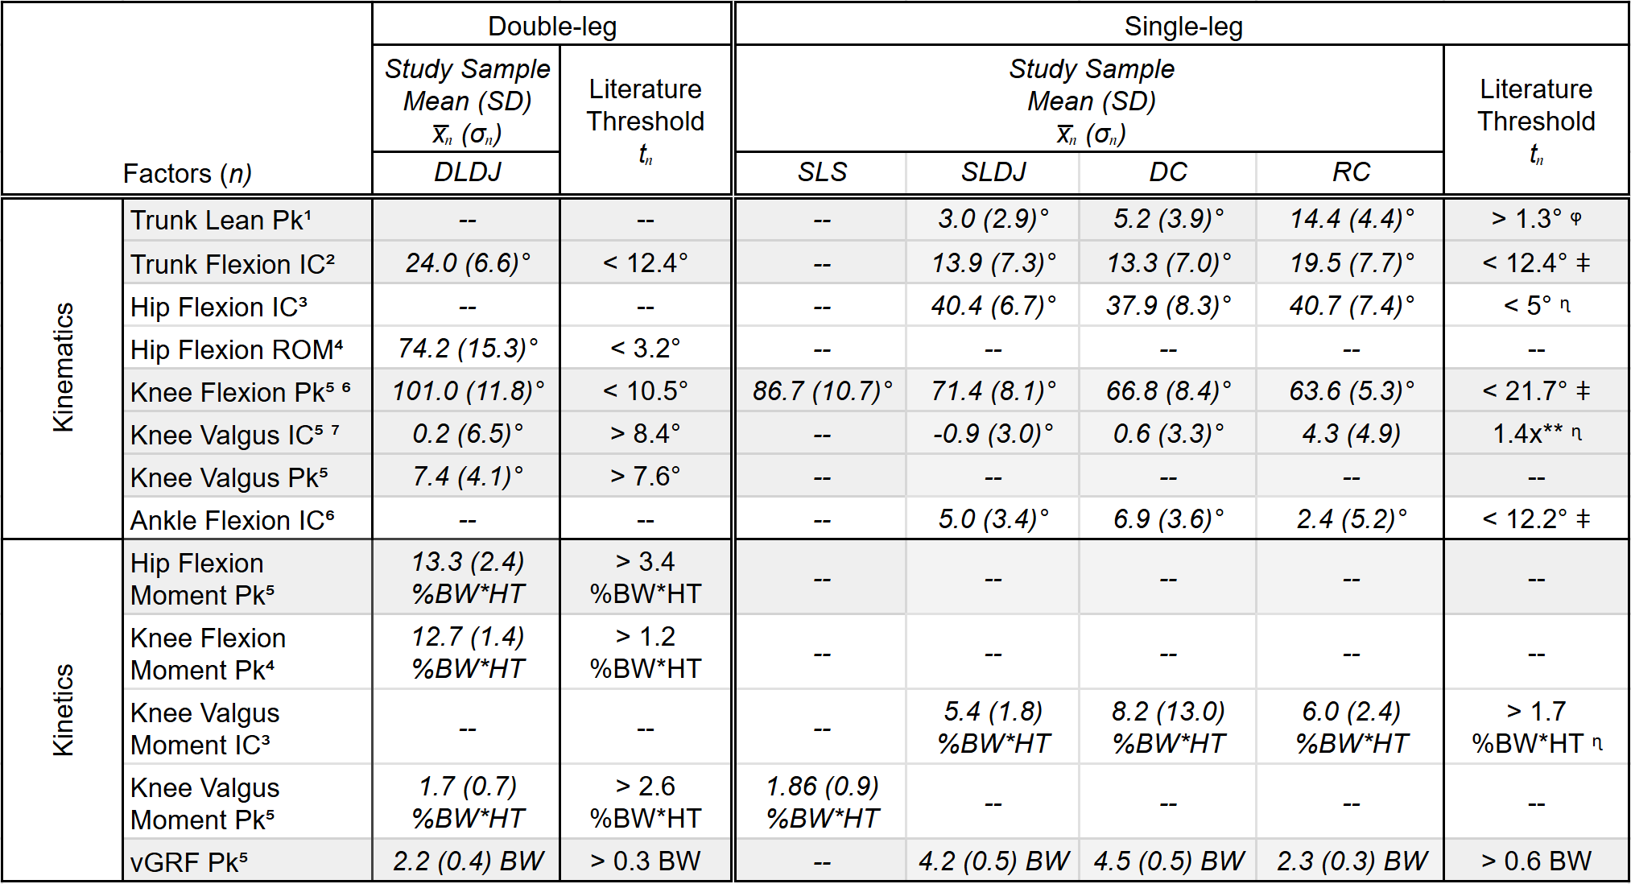
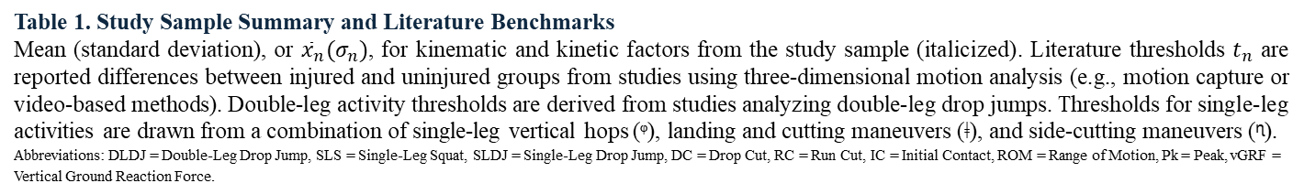
Summary of Literature-based Biomechanical Risk Factors Evaluated for the AIR Score
¹Collings et al., 2022
²Hewett et al., 2009
³Zebis et al., 2022
⁴Leppanen et al., 2017a
⁵Hewett et al., 2005
⁶Boden et al., 2009
⁷Sigurðsson et al., 2025
**1.4-fold increase in risk of ACL injury with each 1 degree increase in knee valgus angle at IC⁷
ᵠ Single-leg triple vertical hop
ǂ Landing and cutting maneuvers
ᶯ Side-cutting maneuver
Table 1. Study Sample Summary and Literature Benchmarks
Mean (standard deviation), or ${\overline{x}}_{n}(σ_{n})$, for kinematic and kinetic factors from the study sample (italicized). Literature thresholds $t_{n}$ are reported differences between injured and uninjured groups from studies using three-dimensional motion analysis (e.g., motion capture or video-based methods). Double-leg activity thresholds are derived from studies analyzing double-leg drop jumps. Thresholds for single-leg activities are drawn from a combination of single-leg vertical hops (ᵠ), landing and cutting maneuvers (ǂ), and side-cutting maneuvers (ᶯ).
Abbreviations: DLDJ = Double-Leg Drop Jump, SLS = Single-Leg Squat, SLDJ = Single-Leg Drop Jump, DC = Drop Cut, RC = Run Cut, IC = Initial Contact, ROM = Range of Motion, Pk = Peak, vGRF = Vertical Ground Reaction Force.

Slide 4
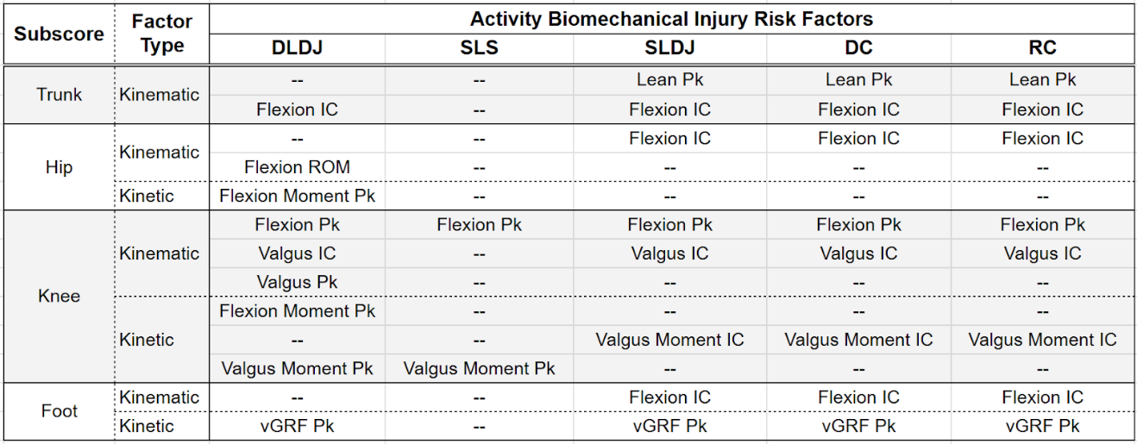
The AIR Score is defined from an optimal set of eight biomechanical risk factors (i.e.,) metrics across two screening activities
Supplemental Table 1. Biomechanical ACL Injury Risk Factors for Each Activity
Kinematic and kinetic biomechanical injury risk factors for each activity that contribute to each AIR Subscore. Subscores are calculated as the sum of resilience factor z-scores from the included activity factors.
Abbreviations: DLDJ = Double-Leg Drop Jump, SLS = Single-Leg Squat, SLDJ = Single-Leg Drop Jump, DC = Drop Cut, RC = Run Cut, IC = Initial Contact, ROM = Range of Motion, Pk = Peak, vGRF = Vertical Ground Reaction Force.

